Slide 1


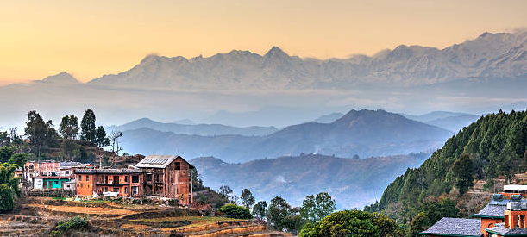

Nepal:
The Himalayan kingdom
https://www.istockphoto.com/photo/bandipur-village-in-nepal-gm521074945-50143520?phrase=nepal&searchscope=image%2Cfilm
DH 107 Communication Techniques
Instructor: Mrs. Smith RDH
Presented by: Megan Walbauer and Dema Al-Nakeeb.
Due: March 1/2024

Slide 2
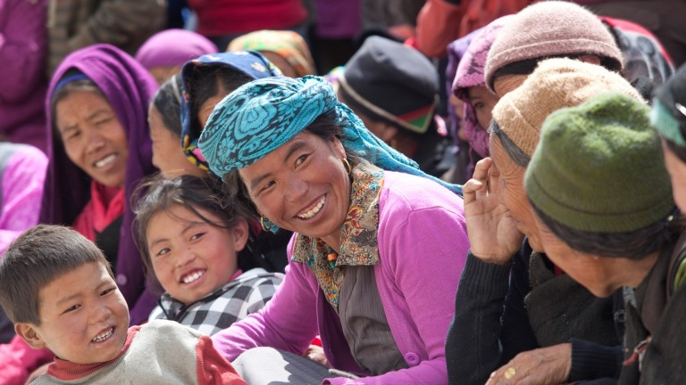
Topics
Communication techniques.
Case Scenario. (Assessment)
Dental hygiene diagnosis.
Planning.
Implementation.
Documentation.
Evaluation.
Difficulties with client.
Conclusion.
Introduction
Interesting facts about Nepal.
Major life events.
Gender roles.
Religious beliefs.
Dietary habits.
General health values, beliefs, and practices.
Oral health values, beliefs, and practices.
Jevaia.
https://ntb.gov.np/en/things-to-do/meet-the-people

Slide 3
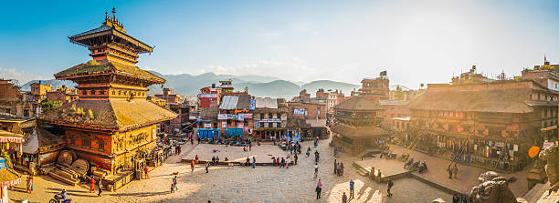
Introduction: ₁₈
z
https://www.istockphoto.com/photo/kathmandu-golden-sunset-light-illuminating-ancient-square-temples-bhaktapur-nepal-gm628303894-111497775?phrase=nepal&searchscope=image%2Cfilm
We chose Nepal as the topic of discussion to widen our cultural education. Nepal consists of a large group of Buddhism, and Hinduism. It's also more famously known to be home to one of the most sought-after mountain to climb for daring mountaineers, being Mt. Everest. We will be discussing a variety of topics including major life events, gender roles, religious beliefs, dietary habits, general and oral health values, beliefs and practices, along with communication techniques, a non-profit dental health organization. Lastly, will review a case study of a recently immigrated person from Nepal and the process of a dental hygiene appointment at CADH.

Slide 4
Interesting facts about Nepal:
Poorest country in Asia. ₁₈.
Only Hindu kingdom in the world. ₁₈
40 different races and tribes. ₁₈
Gold rush herb, which is a rare herb that grows in the meadows in the Himalayan region. Used as a medical remedy for headache, toothache, sexual incompetency or any other disease. ₁₈
More than a 100 languages spoken. ₂₀
8/14 of the world's highest peaks reside in Nepal. ₂₀
Local legends speak about yeti or abominable snowman, some say they’ve seen footprints. ₂₀
Home to Kathmandu, or better known as the City of temples. ₂₀

Slide 5
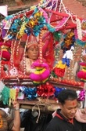
Major life events: Janku and Funerals
Janku: Celebration of life when one reaches a certain age, these are at 77, 1000 months, 88, 99, & 110 years old. Consists of being dressed lavishly and paraded around the city, while visiting different temples. This marks the time when even a small threat can be a serious risk to one's life, they are performed to please the gods and overcome these problems. ₁₇
Sky Burial: Funeral practice in mountainous highlands such as Dolpa in Nepal, this includes specific burial sites, when a corpse is eaten by scavenging animals such as vultures. This is done due to the terrain in the mountains being too rocky and there is a lack of sites for burials.₁₇
In Tibetan tradition its believed that it's not necessary to preserve the corpse after death as it's an empty vessel.₁₇
http://bossnepal.com/janku-celebrations-in-newar/

Slide 6
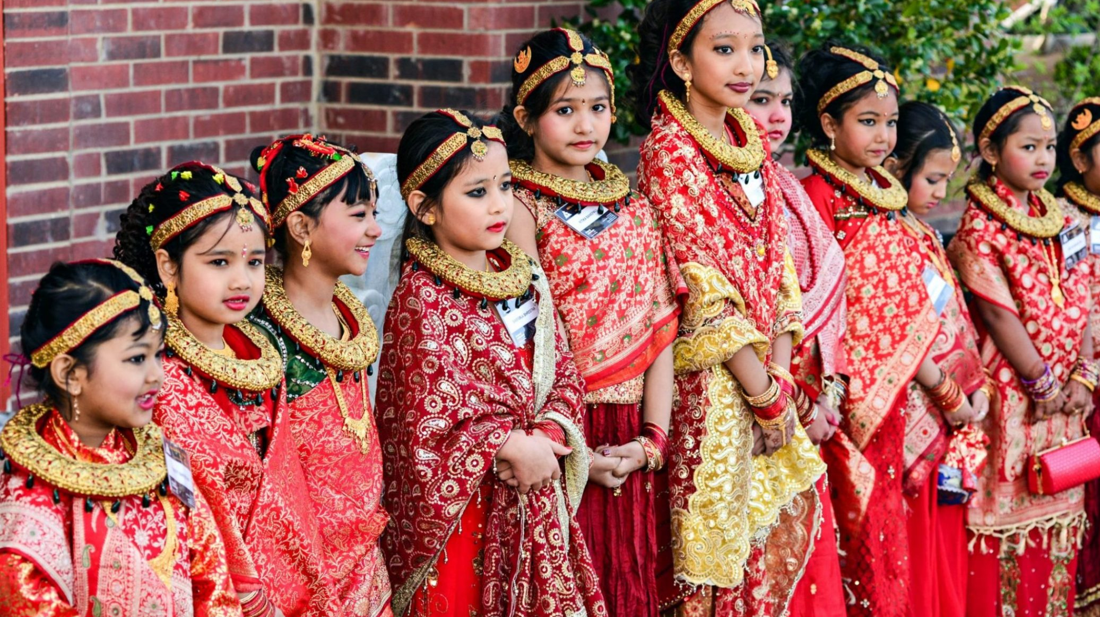
Major life events:
Marriage & Divorce
Both arranged and love marriages are common in Nepal. ₁₇
Divorce is a last resort and normally couples will separate while remaining legally married. ₁₇
Bel Bibaha: Marriage with bael fruit or wood apple the wild fruit is considered a symbol of the lord Vishnu.₁₇
Bahara: Bel Bibaha is followed by Bahara (Sun Marriage), for girls around first menstruation. She will be hidden in a room, with no sunlight for 12 days, after she is given a bath to purify herself and dressed, this is the beginning of women hood.₁₇
These rituals are to ensure that a girl remains chaste and fertile for her life. ₁₇
Marriage with a partner. ₁₇
https://www.between2c.nl/saving-the-brides-of-tomorrow/

Slide 7
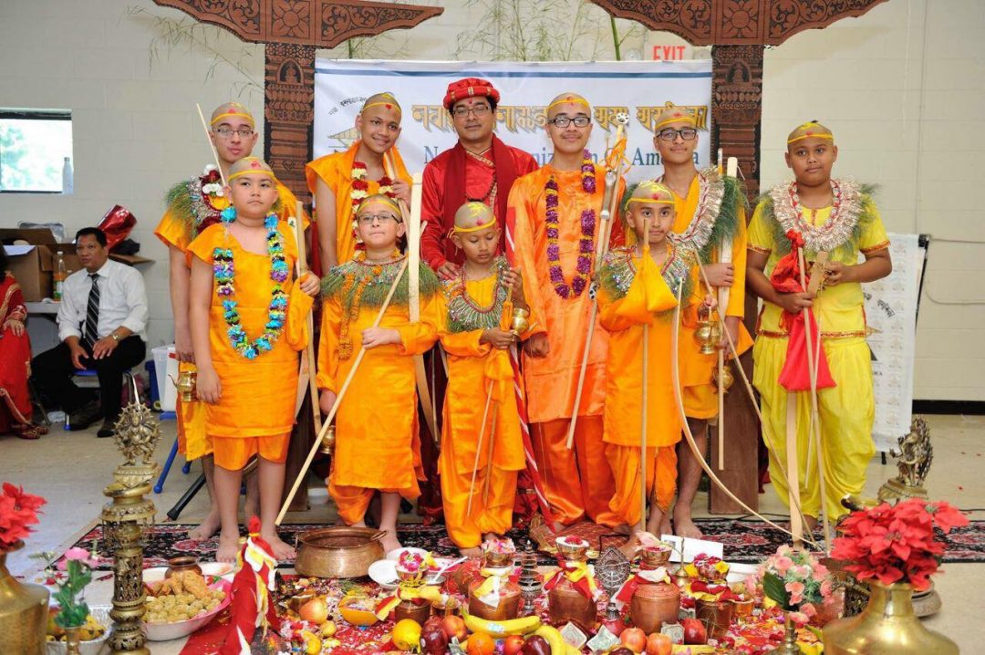
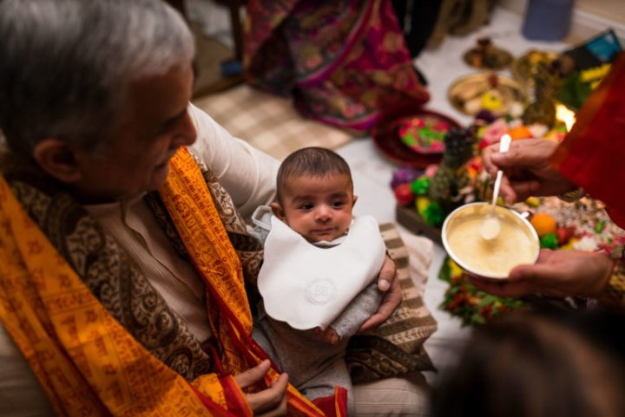
Major life events:
Rice and Name giving ceremony
Nuwaran: Name giving ceremony, for girls its after her 8th birthday, for boys after 9^{th.} Birthday, they utilize date, time, of the birth and alignment of stars. The birth name is necessary, but not normally what a child is known by. ₁₇
Pasni: Rice feeding ceremony, a ceremony celebrated for the first time a child is fed anything other than breast milk and its rice pudding, signifies the growth of an infant to the next stare of life. ₁₇
Bratabandha: Ceremony to transition boyhood-manhood, necessary take place in order to be married, the boys head is shaved along with other traditional rituals, these varies from community to community. ₁₇
https://www.newah.org/event/noas-8th-group-kayeta-puja-bratabandha-ceremony/
https://www.lekbesi.com/astro-services/puja-service/nwaran-puja/

Slide 8
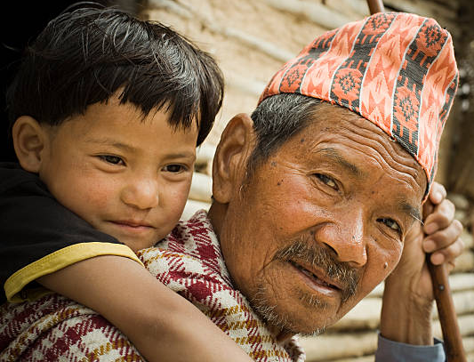
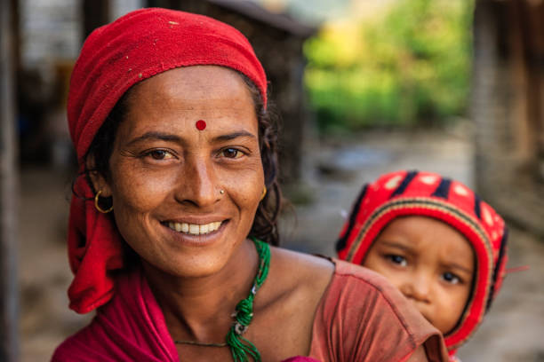
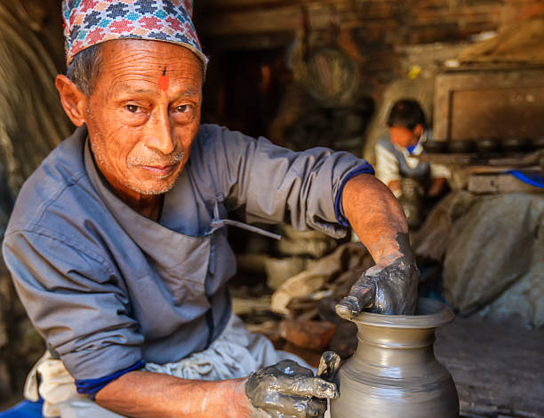
Gender roles: ₆
Women:
Traditional idolization of female purity and power.
Viewed as goddesses, with emphasis on cleanliness and virginity.
Domestic roles are common.
In recent years, more women are joining the workforce.
Woman equality increasing.
Men:
Traditional provider role, especially due to low economic statuses.
Breadwinner.
More job opportunities.
Owned assets in the father, or husbands name.
https://www.istockphoto.com/photo/outdoor-rural-image-of-grandchild-on-grandfathers-piggyback-gm505019038-83460639?phrase=nepal+people&searchscope=image%2Cfilm
https://www.istockphoto.com/photo/nepali-woman-carrying-her-baby-near-annapurna-range-gm861018428-142672263?phrase=nepal+people&searchscope=image%2Cfilm
https://www.istockphoto.com/photo/nepali-potter-working-on-the-pottery-square-in-bhaktapur-gm499872787-43087806?phrase=nepal+people&searchscope=image%2Cfilm

Slide 9
Religious beliefs:
Witch-craft, ghosts, & spirits in rural areas. ₇
Shamans are part of healing processes, through supernatural and human world. ₇
Hinduism most widely followed religion in Nepal; Hindu Kingdom. ₇
All the main religions in Nepal share a daily morning worship ritual of gathering at temples. ₇
Temples built in honour of gods.₇
Buddhism a countermovement to early Hinduism.₇
Theravada Buddhism: The way of the elders.₇
Mahayana Buddhism: Great vehicle.₇
Vajrayana Buddhism: Diamond vehicle.₇
Worship & prayer before major events.₇
https://www.istockphoto.com/photo/kathmandu-golden-sunset-light-illuminating-ancient-square-temples-bhaktapur-nepal-gm628303894-111497775?phrase=nepal+religion&searchscope=image%2Cfilm

Slide 10
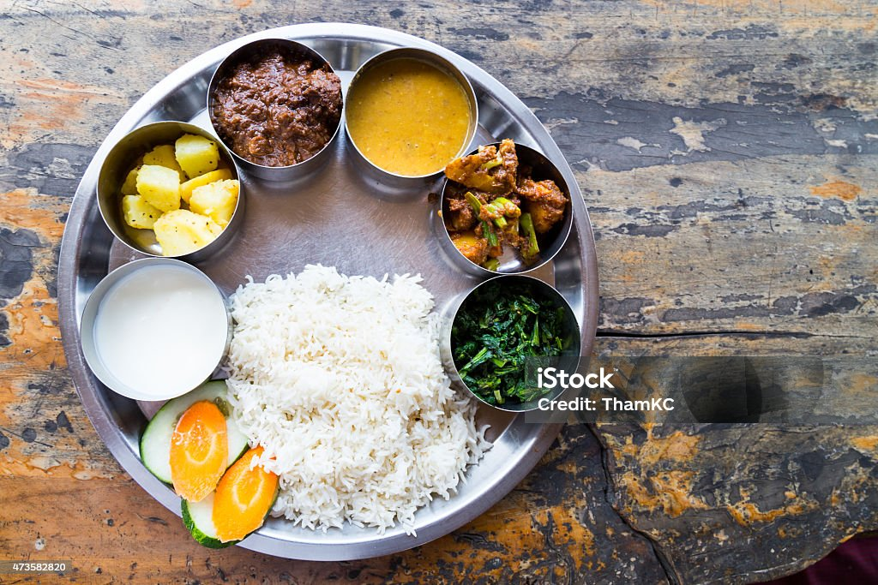
Dietary habits:
Two primary culinary traditions of Indian & Tibetan this reflects the diversity of the Himalayans. ₁₅
Staples of the diet include Rice wheat, corn lentils, fresh vegetables and meats.₁₅
Typically, two meals are eaten a day, breakfast and dinner, dinner being more formal.₁₆
Meals are generally served with rice.₁₆
Due to the poor economic status of Nepal, many don’t have access to meat or fruits and vegetables. ₁₈
People generally tend to eat with their hands instead of cutlery. ₁₆
z
https://www.istockphoto.com/photo/nepali-thali-meal-set-with-mutton-curry-gm473582820-64086827?phrase=nepal+food&searchscope=image%2Cfilm

Slide 11
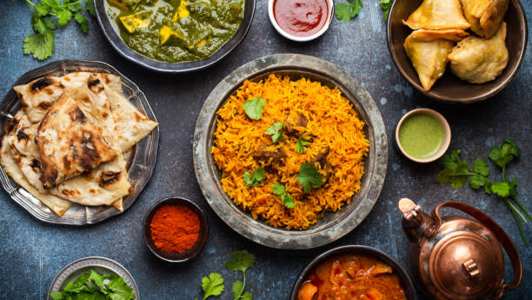
Dietary habits Cont’d:
z
Most of the people in Nepal are not conscious of dietary habits and eat junk food like excessive consumption of fried food.₁₂
Extreme poverty leads to malnutrition in most areas of the country and increase in communicable diseases.₁₂
Other parts suffer from diabetes and hypertension due to the overconsumption of dairy, fats, and carbohydrates. ₁₄
Community schools nationwide now include mid-day meal plan with more dietary habit education.₁₂
Locally grown organic food is being prioritized to increase nutritional intake for the population and decrease systemic health conditions.₁₂
https://www.istockphoto.com/photo/authentic-indian-dishes-and-snacks-gm1152493500-312697283?phrase=nepal+food&searchscope=image%2Cfilm

Slide 12
General health values, beliefs, and practices:
See illness as external, and caused by malevolent power, and an unwelcome entry to the body. ₃
Diagnostic orders for healing are done by soliciting the help of deities, possessed by a healer. ₃
Methods are based on local cultural traditions.₃
Village healers are common and withhold the skill, wisdom, and popularity to treat.₃
Cinta Ceremony: most common tantric healing in rural Nepal, this brings the disease-causing evil spirit out of the victim's body. ₃
Issues with modern facilities include the government not having enough resources to attract doctors. Resulting in poorer health conditions for rural areas.₃
Traditional experts and healers continue to treat the population.₃

Slide 13
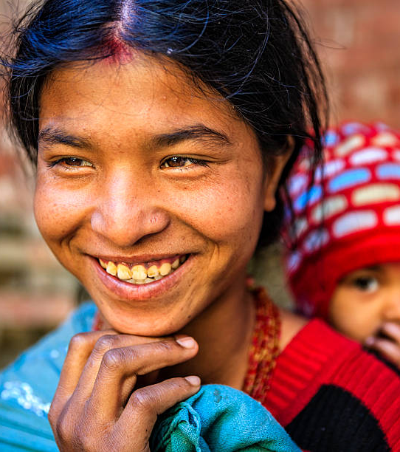
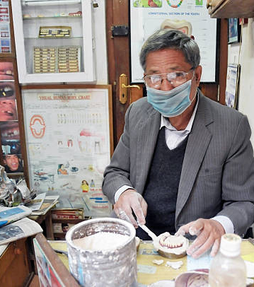
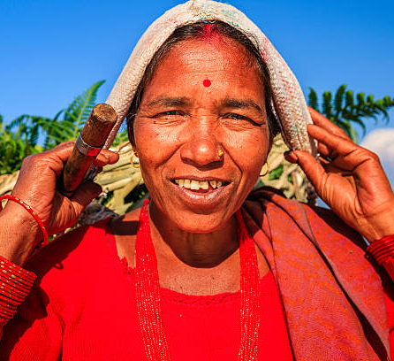
Oral health values, beliefs, and practices:
z
Oral health not a key focus. ₁₈
Rural areas common to brush with finger, ashes, salt or sand. ₁₄
Some people chew Datiwan, which is a stick with antiseptic properties. ₁₄
Local beliefs about the dangers of dental care like tooth extraction can cause deafness and blindness.₁₀
Link of heart disease & diabetes to lack of oral health care._{10,14}
Fluoridated tooth paste uncommon._{10,14}
Lack of education in oral health leading to poor oral health and oral disease._{10,14}
Areas with schools has a lower percent of adults with dental decay.₁₀
Jevaia Foundation.₂
https://www.istockphoto.com/photo/nepali-dentist-making-dental-prosthesis-gm471928995-29641168?phrase=nepal+oral+health&searchscope=image%2Cfilm
https://www.istockphoto.com/photo/young-mother-carrying-her-baby-kathmandu-nepal-gm470167094-62843958?phrase=oral+health+in+nepal&searchscope=image%2Cfilm
https://www.istockphoto.com/photo/nepali-woman-carrying-basket-annapurna-range-on-background-pokhara-nepal-gm496603723-41588606?phrase=oral+health+in+nepal&searchscope=image%2Cfilm

Slide 14
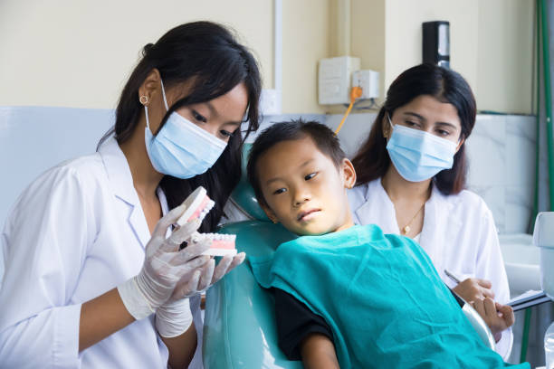
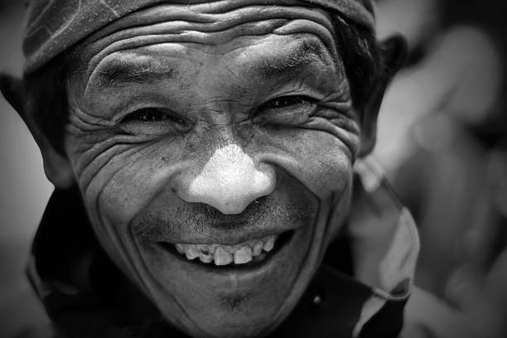
Oral health Cont’d: ₄
z
Percent of children with untreated caries is higher than percent of malnutrition.
Due to poor nutrition, poverty, and high smoking rate, there's higher risk of developing life threatening dental infections.
Oral cancer has the highest morbidity and mortality rate Treatment results in low quality of life due to late diagnosis.
Most common dental problem is dental decay and periodontal disease. _{4, 9}
Mothers who suffer from severe periodontitis give birth to low-birth weight babies.
Discomfort from untreated oral diseases negatively impact quality of life like excessive toothache, lack of sleep, progression of systemic health diseases, financial burden, and lower performance in school.
https://www.istockphoto.com/photo/happy-child-in-dentist-office-with-female-nurses-and-doctors-gm1680799906-536666835?phrase=oral+health+in+nepal&searchscope=image%2Cfilm
https://www.istockphoto.com/photo/portrait-of-an-old-sherpa-gm458120003-19971211?phrase=oral+health+in+nepal&searchscope=image%2Cfilm

Slide 15
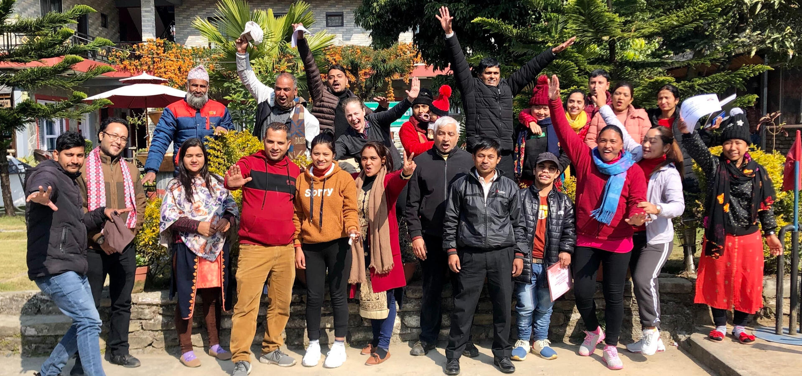
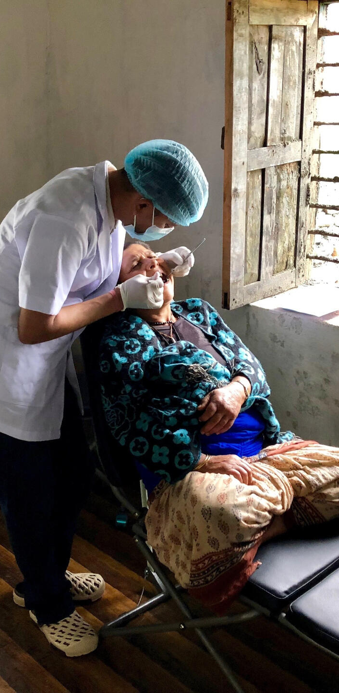
Jevaia: ₂
z
Group of rural and community-based health care professionals, social mobilizers, educators and admins who work with governmental bodies to provide oral health for the Nepalian community.
Hold weekly clinics to provide dental needs and procedures like extractions, topical fluoride, fillings and general cleaning.
Provide school brushing programs to educate students on oral health and provide on-site clinical care for students and teachers.
https://www.jevaia.org/

Slide 16
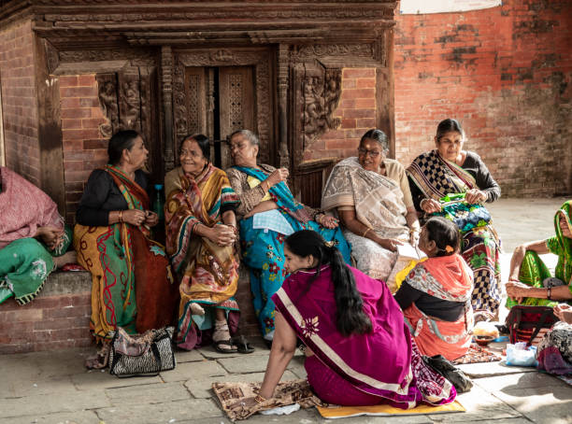
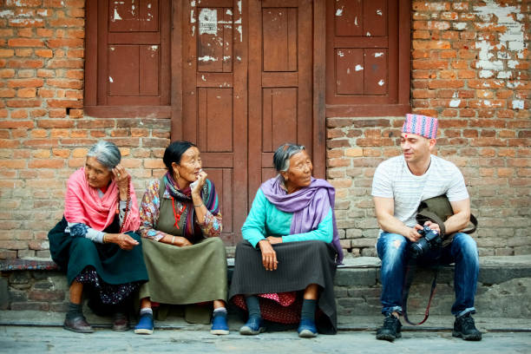
Conservative culture, opposite genders don’t interact in public often. Avoid physical contact with opposite genders.
Indirect communication style is most common in Nepal to avoid confrontations or offense.
Direct communication is reserved for close or trusted relationships.
"Yes" is used to show active listening. Not always indicating agreement.
"No" is not used often because it is considered abrasive or impolite.
Communication Techniques: ₅
z
https://www.istockphoto.com/photo/nepalese-women-chatting-gm1439854087-480002503?phrase=communication+in+nepal&searchscope=image%2Cfilm
https://www.istockphoto.com/photo/european-tourist-talks-with-locals-on-the-street-of-the-old-city-gm696713280-129414285?phrase=communication+in+nepal&searchscope=image%2Cfilm

Slide 17

Communication techniques continued: ₅
Use of open-ended questions are recommended instead of a yes or no questions.
Eye contact is appropriate during conversations with people of same status.
Lower gaze with elders and people with higher status.
Thank you is expressed usually with facial expressions and not verbally saying "thank you”.
Head is seen as most sacred. Touching someone's head is considered insensitive and offensive.

Slide 18
Case scenario: (Assessment)
Patient is a 50-year-old newcomer female from Nepal, she arrived a year ago to Canada. She came for a dental hygiene appointment to get her teeth cleaned and is finding it difficult to communicate with the receptionist and dental hygienist because of the language barrier. The client asked to be seen by a female hygienist preferably due to cultural reasons. Client's main concern was sensitivity and dissatisfaction of overall look of the teeth. Upon completion of medical history examination, it was found that she has an uncontrolled type 2 diabetes and hypertension. Using google translate the dental hygienist was able to find a way around the language barrier to gather more information about the client. She found that in the client's culture, oral health is not given much importance due to the country's economic status and cultural believes. The client mentioned she sometimes cleans her teeth with her fingers using salt or sand.
During the intraoral examination and X-ray examination, it was evident she suffered from severe periodontitis. A tooth on the upper right had a radiographic radiolucency, was later confirmed by the on-site DDS as decay on tooth 16. She also had ulcers in her mouth and her teeth had severe extrinsic staining. She was also missing some maxillary and mandibular posterior teeth and her maxillary lateral incisors.
z

Slide 19
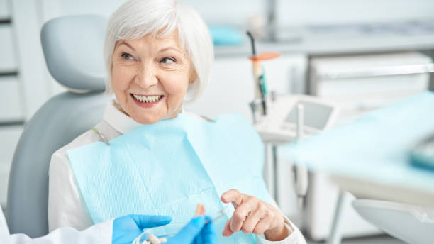
Dental hygiene diagnosis: ₂₁
z
The client suffers from moderate periodontitis with horizontal bone loss, mild extrinsic staining interproximal, and severe abrasion, focused upper and lower anterior. The clients chief concern is severe sensitivity, and complained of her dissatisfaction of her smile due to the extrinsic stains and the way her teeth look. Client's diabetes heightens the development of periodontitis and slows the healing process.
Deficits:
Wholesome facial image. (extrinsic staining,)
Protection from health risks. (diabetes and hypertension)
Biologically sound and functional dentition. (caries)
Freedom from head and neck pain. (ulcers, and sensitivity)
Skin and mucous membrane integrity of head and neck. (periodontitis)
Responsibility for oral health. (lack of oral hygiene care)
Conceptualization and understanding. (language barrier in understanding OHE)
https://www.istockphoto.com/photo/senior-lady-asking-questions-about-dental-dentures-gm1183945375-333069889?phrase=dental+hygiene+elder&searchscope=image%2Cfilm

Slide 20

Planning: ₂₁
z
Dental hygiene care plan is set with goals and diagnosis, interventions are developed, outcomes measures determined, prognosis is made, and appointments are scheduled.
Client-centered goals: goal is to start brushing teeth using soft bristle brush with Sensodyne fluoridated toothpaste once a day. Book an appointment with the dentist to treat the Carie and mouth ulcers.
Client will report having blood pressure evaluated by physician before next visit.
Client will book and appointment with the dentist with the help of the receptionist to treat her caries.
Dental hygiene interventions: debridement, selective coronal polish, Fluoride.
Appointment schedule: start with the 4–6-week re-evaluation, referral to DDS.
https://www.istockphoto.com/photo/i-recommend-a-daily-dose-of-good-dental-hygiene-gm1306143801-396809049?phrase=dental+planning&searchscope=image%2Cfilm

Slide 21
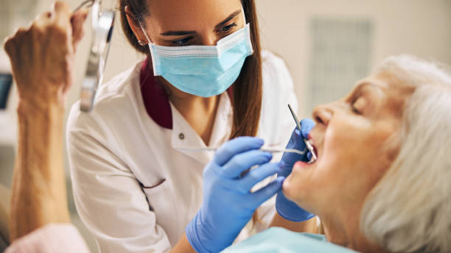
Implementation: ₂₁
z
Obtain informed consent.
Documentation.
Odontogram completion.
Caries assessment.
Periodontal assessment.
EOE/IOE.
Debridement, hand scaling, and ultrasonic instruments.
Selective coronal polish.
Fluoride.
Oral hygiene education, self-care.
Nutritional education (diet recommendation- diabetes and hypertension).
Referral to DDS for caries.
https://www.istockphoto.com/photo/portrait-of-female-dentist-who-treating-teeth-of-elderly-woman-patient-gm1269563123-372859460?phrase=dental+hygienist&searchscope=image%2Cfilm

Slide 22

Documentation: ₂₁
z
Informed consent forms.
Medical history & review.
Record of client medications.
Periodontal, extra oral, intraoral exam, radiographs, oral hygiene status, diet and caries assessment, human needs form, hard tissues assessment & ROC.
Charts completed ( SOAPIE).
Referral forms for DDS.
https://www.istockphoto.com/photo/close-up-of-woman-signing-medical-agreement-at-doctors-office-gm1353453774-428553334?phrase=dental+documentation&searchscope=image%2Cfilm

Slide 23
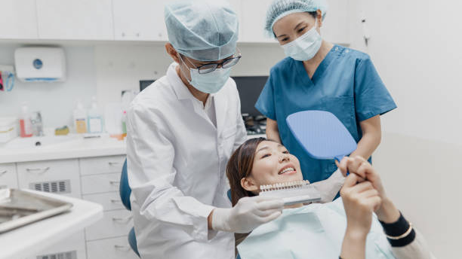
Evaluation: ₂₁
z
Deficit: Freedom from head and neck pain: Goal partially met, deferred patient from using abrasive materials on her teeth as this is likely the cause of the intra oral ulcers and sensitivity. The use of Sensodyne toothpaste and regular brushing has reduced sensitivity but has not completely eliminated it. ₂₁
Deficit: Responsibility for oral health care. Goal partially met, Modified the goals because the client was finding it difficult to brush. Educated client and modified technique to circular technique instead of modified bass and recommend brushing once a day.
Deficit: Protection from health risk. Goal met by client booking appt with physician and getting medication for diabetes and hypertension.
Deficit: Skin and mucous membrane integrity of head and neck. Goal met by completion of debridement and removal of extrinsic stains, by hand and ultrasonic scaling, soft deposit removal, and prophy polish done by the hygienist.
Deficit: Conceptualization and understanding. Goal met by using google translate for initial appointment and followed up by bringing a translator to next appointment.
https://www.istockphoto.com/photo/medical-care-asian-female-patient-in-consultation-with-her-dentist-for-her-teeth-gm1404043205-456384067?phrase=dental+evaluation&searchscope=image%2Cfilm

Slide 24

Difficulties with client:
Overall difficulties with client included
Language barrier. Was able to use google translate to communicate, and advised for next visit to bring a translator if that is easier, perhaps a relative or partner who is English and native speaking language.
Cultural communication style where client was not direct in communicating concerns and goals. Was patient in asking questions in different ways to get the answer needed.
Client preferred female hygienist, luckily was available.
Communicated all steps to be performed before proceeding and acquired consent to treatment. Client was hesitant with hygienist being in close proximity to the head. Assured everything is done with consent.
z
https://www.istockphoto.com/photo/impossible-concept-with-businessman-and-wooden-blocks-gm1096393440-294386592?phrase=difficulties&searchscope=image%2Cfilm

Slide 25
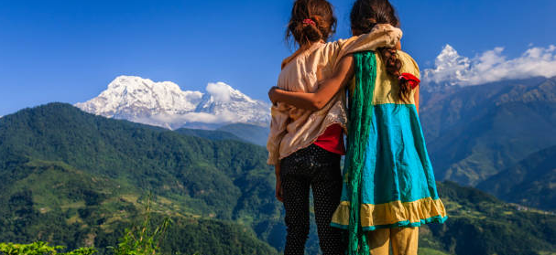
Conclusion
z
https://www.istockphoto.com/photo/nepali-little-girls-looking-at-annapurna-south-gm903603912-249212027?phrase=nepal&searchscope=image%2Cfilm
Upon completing the research for this assignment, we have come to the conclusion that Nepal is an incredibly culturally rich country, with ceremonies, traditions, and religion-based practices. These are especially prevalent for coming-of-age events, and certain life passages. Some people in Nepal have a deep spiritual understanding of their world and the body/mind, that others may not. As students, it's important to learn about these values to better align with the wide variety of clientele we will be working with.

Slide 26
Literature cited
1. Burden OD. Nepal oral health country profile. Who.int. 2022. Available from: https://cdn.who.int/media/docs/default-source/country-profiles/oral-health/oral-health-npl-2022-country-profile.pdf?sfvrsn=1e39b720_9&download=true. Accessed February 28, 2024
2. Jevaia Oral Health Care. Jevaia foundation [Internet]. Available from: https://www.jevaia.org/. Accessed February 28, 2024
3. Khatry, PK. The Nepalese traditional concepts of illness and treatment [Internet]. 2011 [cited 2024 Feb 28]; Vol. 1. Available from: https://www.dadarivista.com/Singoli-articoli/2011-dicembre/pa3.pdf
4. Ministry of Health and Population, Nepal. National Oral Health Policy. Available at: https://mohp.gov.np/uploads/Resources/1657877144550National%20Oral%20Health%20Policy.pdf. Accessed Feburary 28, 2024.
5. Nepalese Culture. Cultural Atlas. 2017 [Internet]. Available from: https://culturalatlas.sbs.com.au/nepalese-culture/nepalese-culture-communication. Accessed February 28, 2024
6. Nepalese Culture. Cultural Atlas. 2017 [Internet]. Available from: https://culturalatlas.sbs.com.au/nepalese-culture/nepalese-culture-family. Accessed February 28, 2024
7. Nepalese Culture. Cultural Atlas. 2017 [Internet]. Available from: https://culturalatlas.sbs.com.au/nepalese-culture/nepalese-culture-religionAccessed. Accessed February 28, 2024
8. Nepali Times. Bel Bibaha. 2019 Dec 08 [Internet]. Available at: https://nepalitimes.com/news/bel-bibaha. Accessed February 28, 2024.
9. Oral health in Nepal. Dentistry IQ. 2013 [Internet]. Available from: https://www.dentistryiq.com/dental-hygiene/clinical-hygiene/article/16354269/oral-health-in-nepal. Accessed February 28, 2024.
z

Slide 27
Literature cited
10. Pulitzercenter.org. Obstacles to providing oral healthcare in Nepal. 2013 Sep 03 [Internet]. Available from: https://pulitzercenter.org/stories/obstacles-providing-oral-healthcare-nepal. Accessed February 28, 2024
11. Rose LE. history of Nepal. In: Encyclopedia Britannica. 2023 [Internet]. Available from: https://www.britannica.com/topic/history-of-Nepal. Accessed Feb 28, 2024
12. Pudasaini A. Examining the nutritional status and eating habits of Nepali adolescents. admin. 2023 Jul 08 [Internet]. Available from: https://english.onlinekhabar.com/nutrition-eating-habits-nepali-youth.html. Accessed February 28, 2024
13. Singh A, Shrestha A, Bhagat TK, Baral DD. Assessment of oral health status and treatment needs among people of Foklyan area, Dharan, Nepal. BMC Oral Health [Internet]. 2020 [cited 2024 Feb 28]; 20(1). Available from: https://bmcoralhealth.biomedcentral.com/articles/10.1186/s12903-020-01312-2#:~:text=In%20Nepal%2C%20the%20caries%20prevalence,deep%20periodontal%20pocket%20%5B2%5D
14. The Washington Post. A Bethesda native works to improve dental care in Nepal. 2013 Aug 29 [Internet]. Available at: https://www.washingtonpost.com/lifestyle/magazine/a-bethesda-native-works-to-improve-dental-care-in-nepal/2013/08/29/77a8e964-003e-11e3-96a8-d3b921c0924a_story.html#. Accessed February 28, 2024.
15. Together Women Rise. Nepal: Customs and Cuisine. 2023 [Internet]. Available at: https://togetherwomenrise.org/customsandcuisine/nepal/#:~:text=The%20Nepali%20staples%20consist%20primarily,supplemented%20by%20some%20meat%20preparation. Accessed February 28, 2024.
z

Slide 28
Literature cited
16. Top Asia Tour. Food culture in Nepal. 2016 [Internet] Available at: https://www.topasiatour.com/nepal/food-culture-in-nepal.html. Accessed February 28, 2024.
17. Unique traditions in Nepal. HoneyGuide. Feb 9, 2016 [Internet]. Available from:https://honeyguideapps.com/blog/unique-traditions-in-nepal. Accessed February 28, 2024
18. VisitNepal.com-Travel Information Network. Nepal tourism information center and phone number of Birgunj, Pokhara, Bhairahawa, Janakpur, Kakarbhitta - Visitnepal.com 2012 [Internet]. Available from: https://www.visitnepal.com/nepal_information/general.php. Accessed February 28, 2024
19. World Health Organization. Oral health Nepal 2022 country profile. 2022 Nov 18[Internet]. Available from: https://www.who.int/publications/m/item/oral-health-npl-2022-country-profile. Accessed February 28, 2024.
20. 11 interesting facts about Nepal which will amuse you. 2015 Sept [internet]. Available from: https://www.himalayanglacier.com/interesting-facts-about-nepal/ Accessed Feb 26, 2024.
21. Bowen and Pieren. Darby and Walsh dental hygiene theory and practice. 5th ed. 3251 Riverpost lane, Maryland Heights. Elsevier. 2020. pg 164-401
z

