Slide 1

Healthcare Observation
Group A: Pharmacy
DH304 – Interprofessional Collaborative Practice
Ms. Steinberg, RDH
Megan Walbauer, Maria Kurba Alakhras, Gurleen Dhaliwal, Dema Al-Nakeeb,
Jaipreet Singh, Zaid Saoor

Slide 2
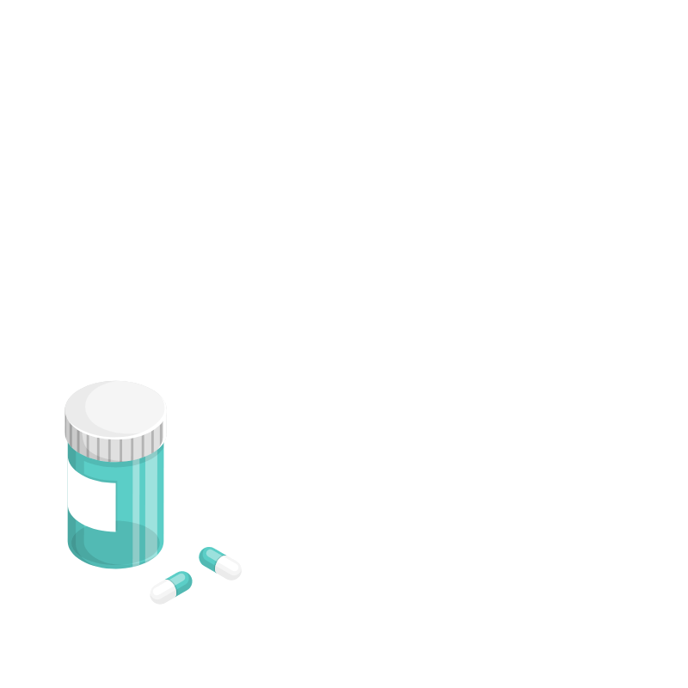
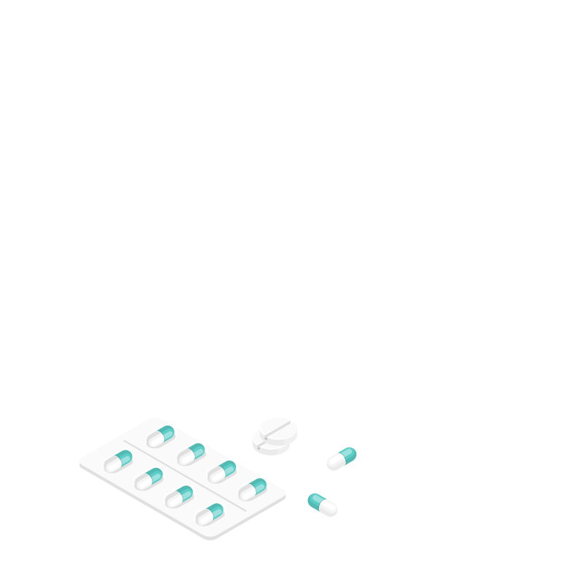
Table of Contents:
Introduction to the profession
Profile of Profession
Knowledge
Roles and Responsibilities
Skills​
Q & A
Literature Cited

Slide 3
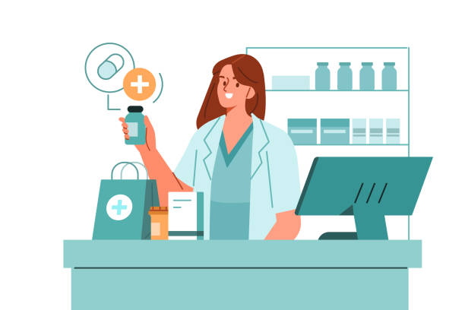
Introduction To The Profession
Pharmacists are healthcare providers that prescribe and provide medications.
Can provide immunizations.
Work in different settings:
  hospitals, grocery stores, pharmacies, primary care offices, and other healthcare facilities.
Verify prescriptions making sure they do not contraindicate other medications a client is taking.
Provide information on how to take a medications and any potential side effects.
Notes:
https://my.clevelandclinic.org/health/articles/24786-pharmacist
Image:
https://www.istockphoto.com/search/2/image?mediatype=illustration&phrase=pharmacist

Slide 4

Profile of Profession
Licensed with the Ontario College of Pharmacists (OCP).
A people-oriented profession that works alongside other healthcare professionals.
Provide patients with knowledge of medication usage, side effects, and interactions.
Notes:
https://www.opatoday.com/become-a-pharmacist/#:~:text=It%20takes%20at%20least%20five,therapeutic%20knowledge%20and%20clinical%20skills.
https://my.clevelandclinic.org/health/articles/24786-pharmacist
Image:
https://www.istockphoto.com/search/2/image?mediatype=illustration&phrase=pharmacist

Slide 5

Types of Clients Pharmacists Interact With
Pharmacists deal with patients of all ages, from infants to seniors.

Slide 6

NEW: Minor Ailments
As of October 1, 2023, pharmacists are allowed to prescribe certain medications for 19 minor ailments.
Minor ailments are health conditions that require minimal treatment and/ or self-care strategies.
All pharmacists were required to complete a mandatory orientation for this change in the scope of practice.
  But not all pharmacies are required to provide this service.
Notes:
https://www.ocpinfo.com/practice-education/expanded-scope-of-practice/minor-ailment/

Slide 7
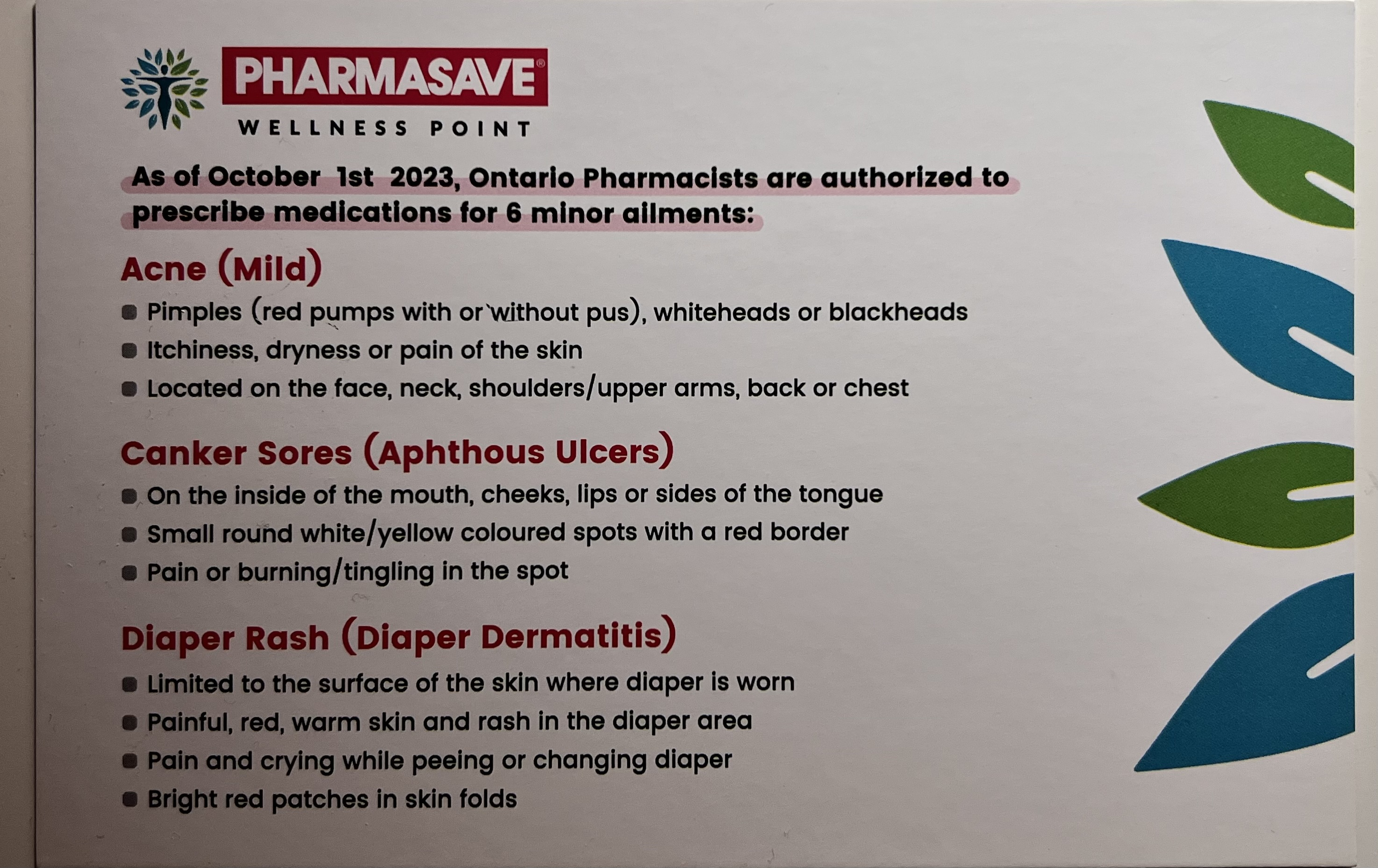
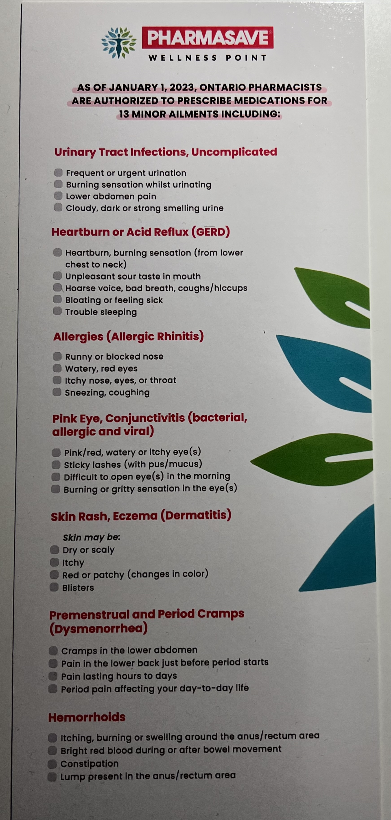
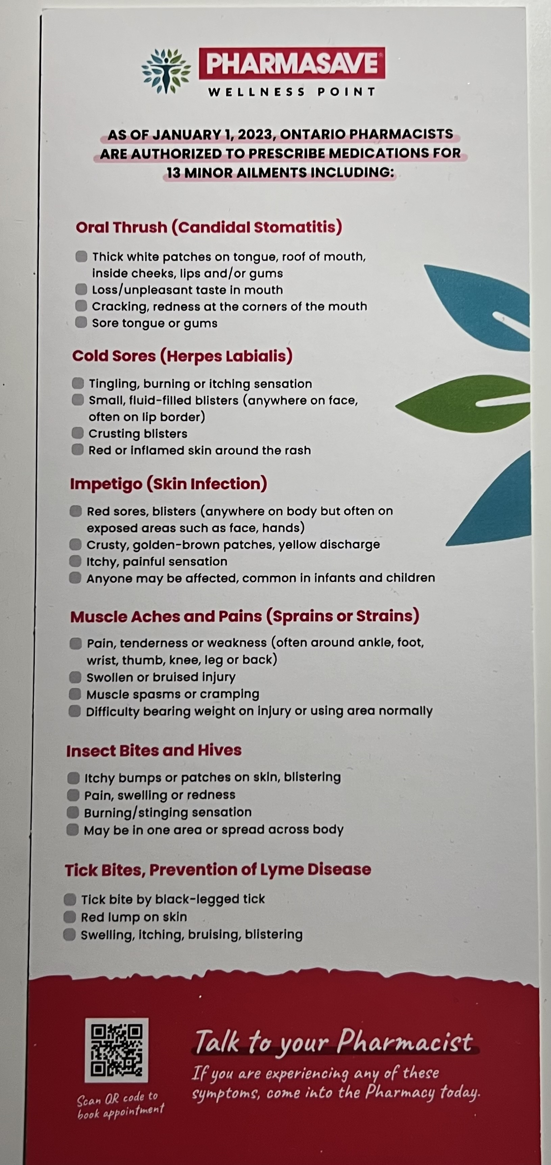
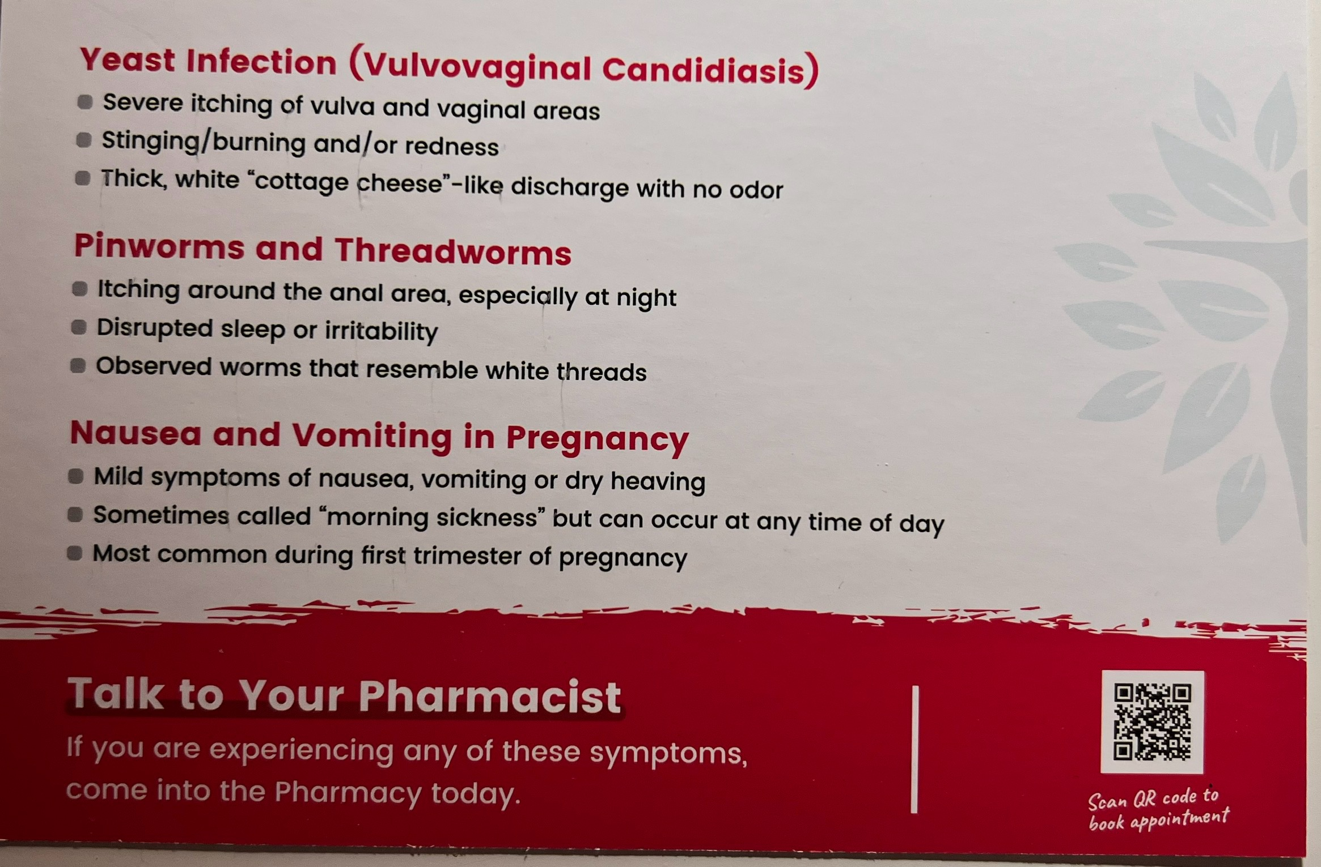
NEW: Minor Ailments
Patients are encouraged to speak with their pharmacist to learn more about this healthcare service.
Some of the minor ailments include:
  Diaper rash, pink eye, canker sores, muscle aches, and insect bites
Notes:
https://www.ocpinfo.com/practice-education/expanded-scope-of-practice/minor-ailment/

Slide 8
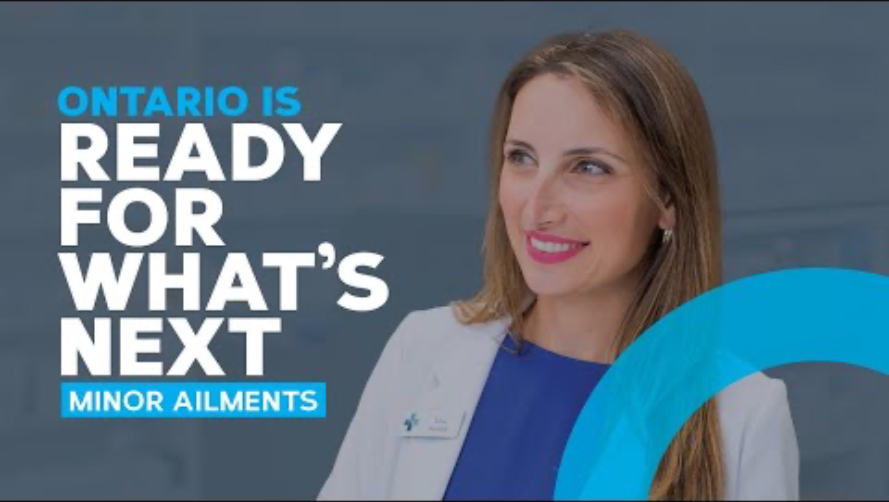
Notes:
https://www.youtube.com/watch?v=ZnipjYaXqH8

Slide 9

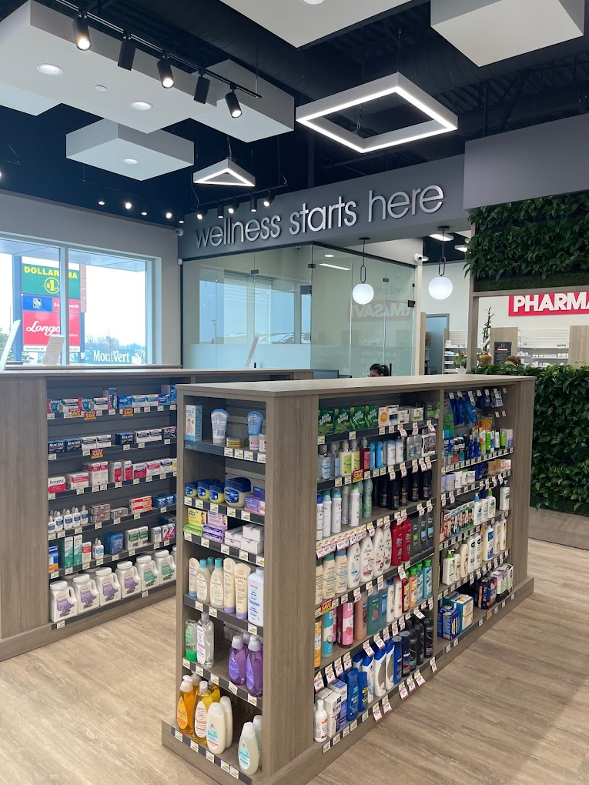

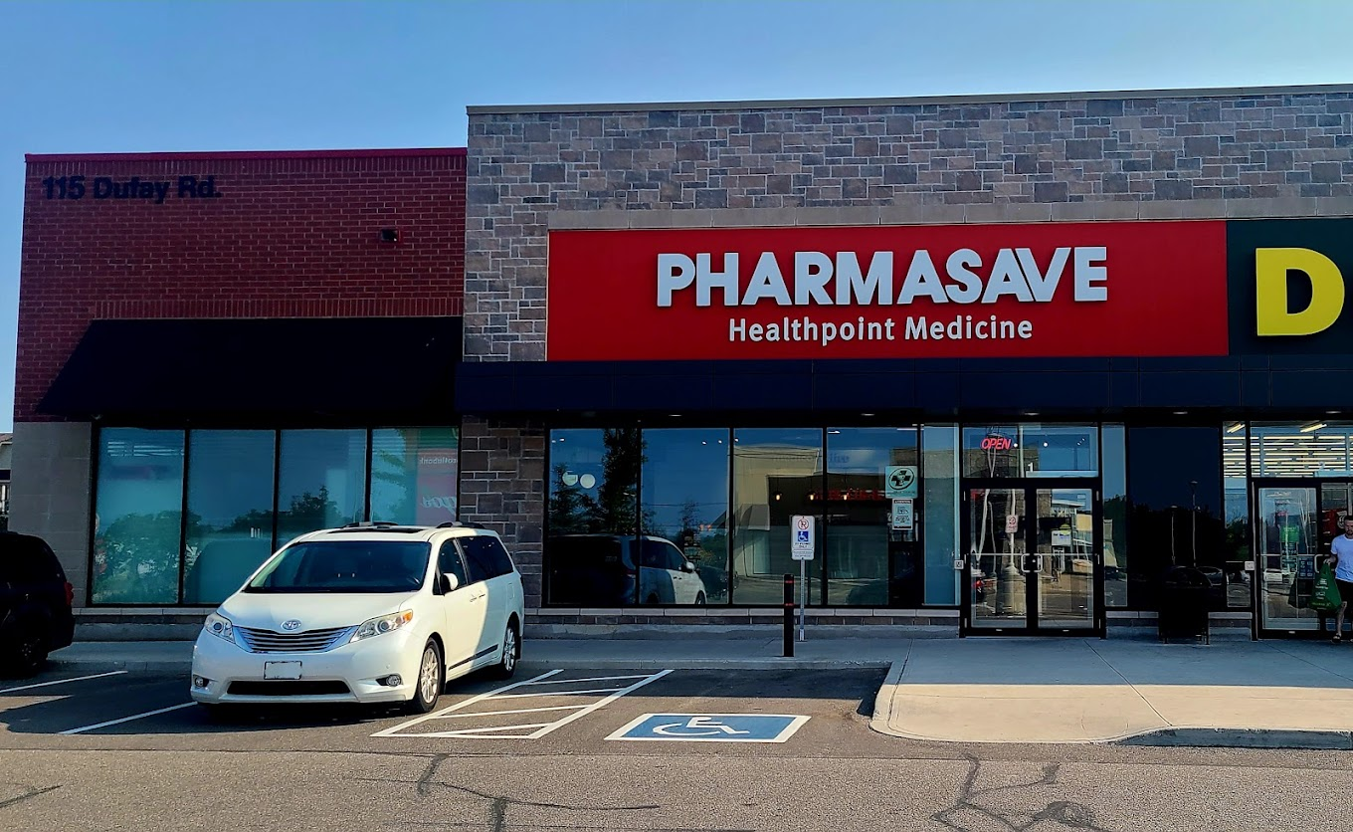
115 Dufay Rd, Brampton ON
L7A 0B5
Wellness Point Pharmacy-
Gurleen's Experience
Dr. Ali Walji (Pharmacist)
Graduated from UCL School of Pharmacy.
Licensed with Ontario College of Pharmacists.
Works with clients of all ages.
Very professional and had great communication with patients.
There are different peaks in the day where work-flow varies between busy to slow.
Notes:
https://wellnesspoint.ca/our-team/

Slide 10
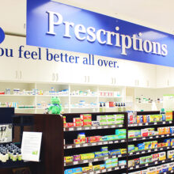
Inax (Reflex Medical Center) -
Dema's Experience
Inass Kassab
Studied at the College of Pharmacy-University of Mosul in Iraq.
Accredited her degree in Canada in 2015.
Linked to the clinic in the building.
Pharmacists are now allowed to change the type of delivery (capsule vs liquid) and dosages.
Bill insurances.
For narcotics:
  Doctor must write health card on prescription and doctor license number.
  Check patient ID before giving.
Preparation of prescriptions:
  medications from shelf, or prepare by mixing
Answer patient questions in person or over the phone
Provide flu shots.

Slide 11

Shoppers Drug Mart –Megan’s Experience:
Mehran Sabbaghi, RPh
Pharmacy manager.
Bachelor of science and pharm D program.
Professional.
Well organized pharmacy with intricate labelling system to ensure medications can be found with ease.
Flow of system worked seamlessly.
Double counting narcotics.
Very knowledgeable.
Notes:
https://www.burnabynow.com/local-news/burnaby-shoppers-drug-mart-reports-another-covid-19-case-3161001

Slide 12
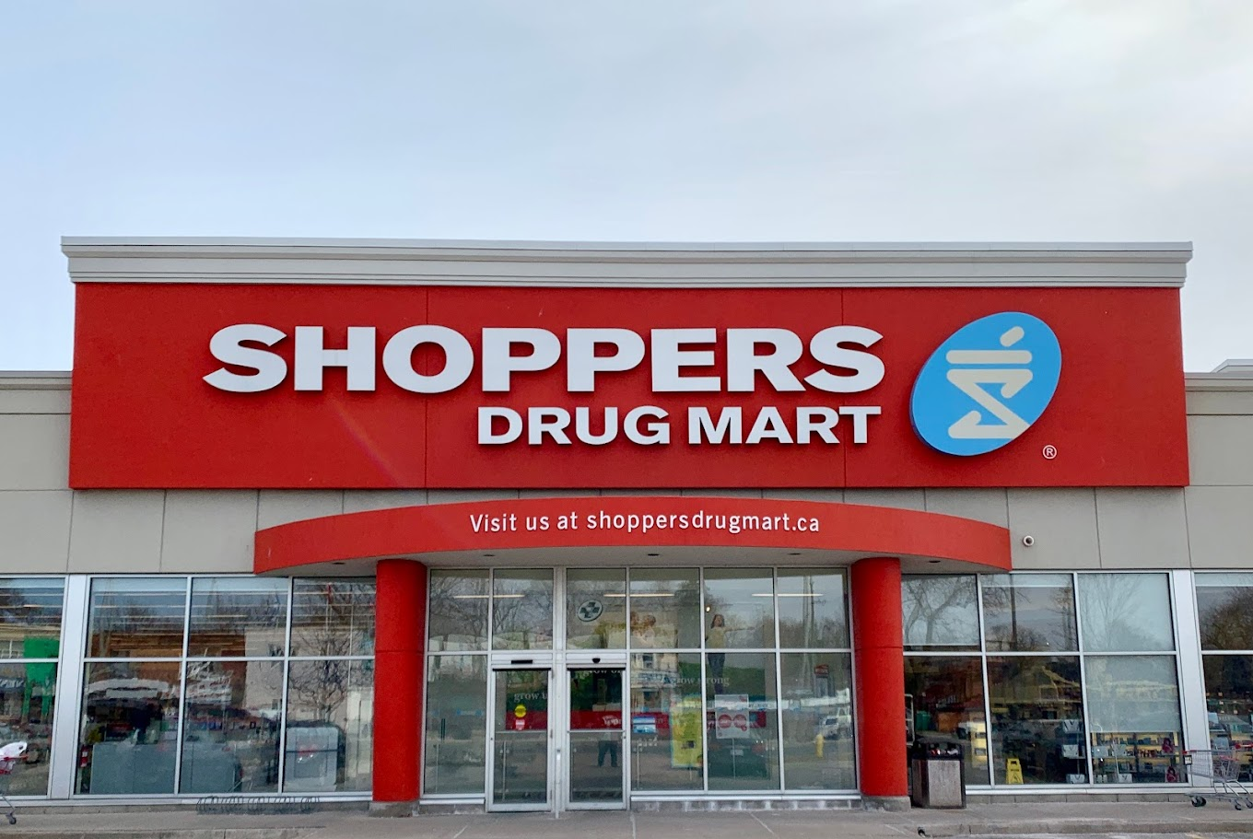
Shoppers Drug Mart- Jaipreet's experience
Rania Hanna
  Office owner .
  Fast paced environment
  Observed workflow and operations.
  Sorted medications.
  Applied expiry dates to medications.
  Organized and efficient work environment.

Slide 13
Shoppers Drug Mart- Maria's experience
Pharmacist Rami Daoud
Fax, drop off, or E-Prescriptions.
Limited Supply: patients would receive a 7-day supply until the order arrives. New label printed that shows ''14 pill out of 46."
After filling, the technician takes the medication to the pharmacist for verification.
Medications not dispensed after 3 weeks are cancelled.
Checked monthly and sent to Stericycle for disposal if expired.
Narcotic meds are manually counted twice: once by technician and once by the pharmacist.
Arranged by generic name in the front and brand name in the back in alphabetical order.

Slide 14
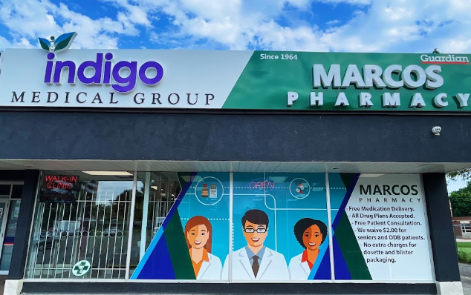
Marcos Pharmacy (Methadone Clinic)
What a pharmacist's day looks like behind the counter? Getting the opportunity to look at the day-to-day duties of a pharmacist, from educating, dispensing prescriptions and managing.
Patient Interaction: Observe how pharmacist communicate with patients, from addressing their concerns and needs to providing advice.
Medication Management: How the pharmacists handle, dispense, and counsel patients about their medications.
Collaboration: Observe pharmacist interaction with other healthcare providers to ensure complete patient care.
Problem-Solving Skills: problem-solving and critical thinking skills required to address any issue pops up during the day.
Knowledge of new Technologies: observing the system and technology being used for inventory management and medication dispensing .

Slide 15
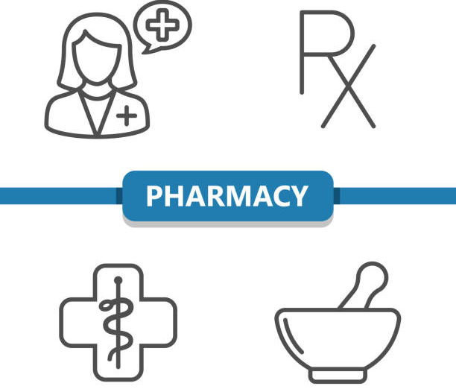
KNOWLEDGE
Notes:
https://www.istockphoto.com/search/2/image?mediatype=illustration&phrase=pharmacist

Slide 16

Knowledge
Educational requirements to become a licensed pharmacist in Canada.
Must be fluent in English or French.
Highschool Degree with required courses of:
  English
  Chemistry
  Physics
  Biology
  Math
Completed a minimum of 8-16 full credit undergraduate university-level courses with a cumulative average of 70% (1-2 years of undergraduate studies in life biology or life sciences).
A doctor of pharmacy degree (4 years) from one of the 11 Canadian universities.
Pass the national board exam– Pharmacy Examining Board of Canada (PEBC).
Practical experience through an internship.
Can choose to pursue post-graduate studies: Master, One-year Residency program in a hospital, One-year Residency program in a pharmaceutical company.
Register with Ontario College of Pharmacists (OCP).
Notes:
https://www.opatoday.com/become-a-pharmacist/#:~:text=It%20takes%20at%20least%20five,therapeutic%20knowledge%20and%20clinical%20skills.%E2%80%8B
https://www.pharmacists.ca/pharmacy-in-canada/becoming-a-pharmacist-in-canada/
https://www.pharmacy.utoronto.ca/how-become-pharmacist

Slide 17
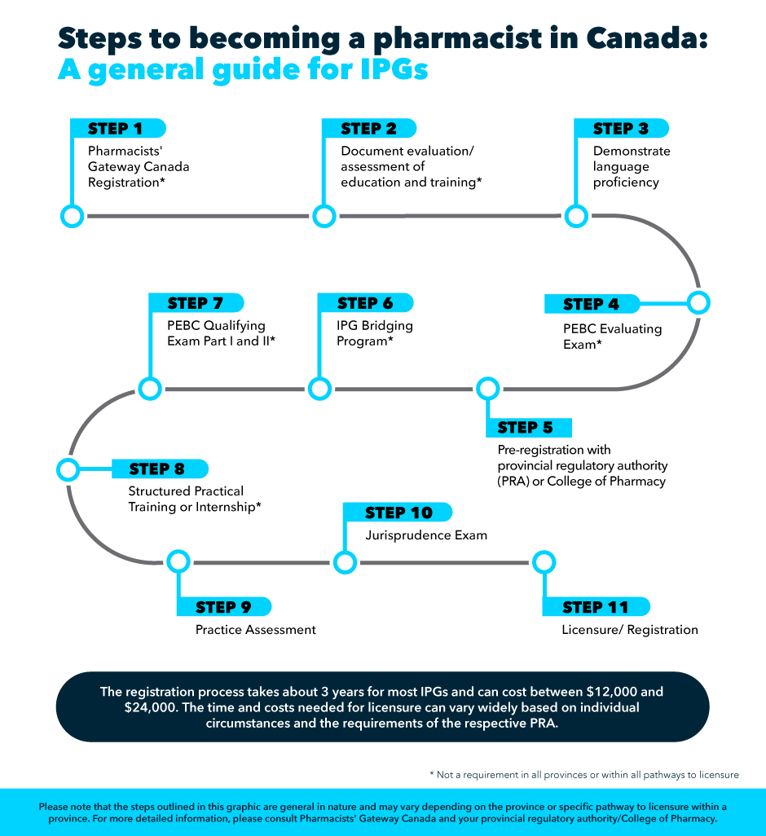
Notes:
https://www.pharmacists.ca/pharmacy-in-canada/becoming-a-pharmacist-in-canada/

Slide 18



Special License or Membership
Must be registered with the Ontario College of Pharmacists (OCP).
Other organizations are:
  Ontario Pharmacists Association.
  Canadian Pharmacists Association.
Notes:
https://www.ocpinfo.com/about/council-committees/

Slide 19

Types of Pharmacists
Community Pharmacists
  Work in retail stores (eg. Drug store or independently owned)
Clinical Pharmacists
  Work in hospitals or other healthcare settings
  May care for patients one-on-one in outpatient office.
Consultant Pharmacists
  Advise healthcare and insurance companies on patient medication use.
Pharmaceutical Industry
  Work in areas of sales, marketing, or research and development.
Nuclear Pharmacists
  Prepare and distribute radiopharmaceuticals or radioactive drugs.
Notes:
https://my.clevelandclinic.org/health/articles/24786-pharmacist

Slide 20

ROLES:
Notes:
https://www.istockphoto.com/search/2/image?mediatype=illustration&phrase=pharmacist

Slide 21

Health care professional's pharmacists work with:
What kind of health care professionals do pharmacists work alongside?
  Doctors
  Dentists
  Nurses
  Nurse practitioners
  Other pharmacists
  Medical/dental/pharmacy receptionists
  Pharmacy technicians
  Pharmacy assistants

Slide 22


Scope of Practice for Pharmacists:
The scope of practice includes:
  Dispensing medication
  Compounding and selling medication
  providing consultations
  Communication with clients
  Directing clients on medication usages
  Recommendations for over-the-counter medications
  Administration of certain substances
  Prescriptions of certain medications such as renewal or emergency refill
  Smoking cessation
  Vaccinations
  Treatment for minor ailments
Notes:
https://www.wallpaperflare.com/silver-stethoscope-medicine-graph-chart-diagram-close-up-wallpaper-mlmt

Slide 23
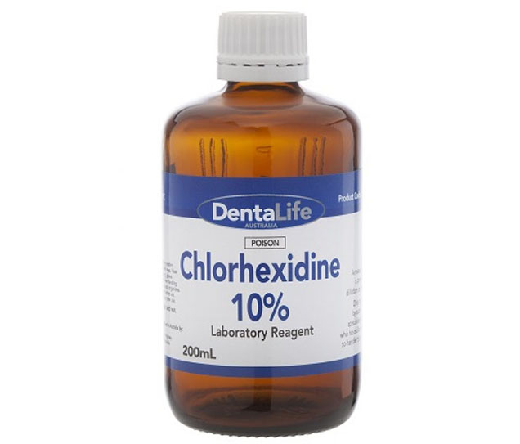
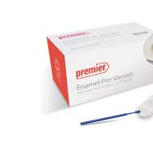
The Roles of Dental Hygienist and Pharmacists:
What are two things can hygienists prescribe?
Chlorhexidine
Fluoride
This allows hygienists to provide care and ensure that clients are receiving the necessary therapeutic benefits.
Notes:
https://www.ihs.org.vn/chlorhexidine-9107.html
https://www.google.com/imgres?q=fluoride%20varnish%C2%A0&imgurl=https%3A%2F%2Fwww.premierdentalco.com%2Fwp-content%2Fuploads%2F2015%2F08%2FEP_Varnish_Box_new-unitdose_web.jpg&imgrefurl=https%3A%2F%2Fwww.premierdentalco.com%2Fproduct%2Fhygienepreventative%2Ffluoride%2Fenamel-pro-varnish%2F&docid=teDzh6rhBYroDM&tbnid=IjfXlWTDqWg5CM&vet=12ahUKEwi2m6GSwYyKAxUzmokEHWvLGiQQM3oECG0QAA..i&w=1200&h=800&hcb=2&ved=2ahUKEwi2m6GSwYyKAxUzmokEHWvLGiQQM3oECG0QAA

Slide 24

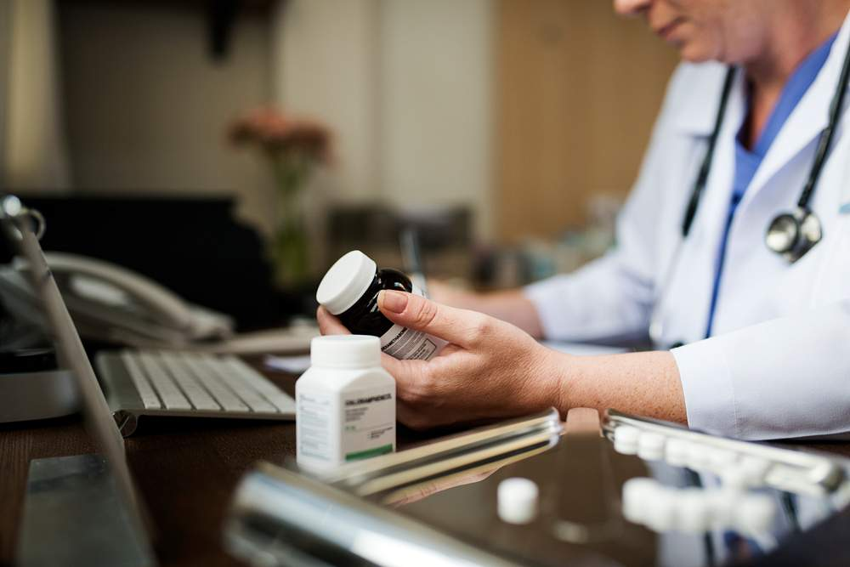
The Relationship Between Hygienists & Pharmacists:
The interactions would be minimal compared to another health care provider such as a dentists or medical.
Prescriptions of either chlorhexidine or fluoride
Potential for discussion with pharmacist to discuss client
Receiving medication lists for clients’ during medical history review
Hygienists are not present in pharmacies.
Notes:
https://www.rawpixel.com/search/pharmacist?page=1&path=_topics&sort=curated
https://www.mynextmove.org/profile/summary/29-1292.00

Slide 25

Pharmacist workday based off shadow placement:
Many tasks are included in a typical workday those include:
Entering, transcribing and comparing prescriptions.
Ensuring the correct dosage is being prescribed and counted.
Changing dose, duration and format when necessary.
Ensuring medication is verified and correctly entered.
Ensuring medication leaving with client is correct and accurate.
Acting as a safeguard for medication being prescribed to clients.

Slide 26
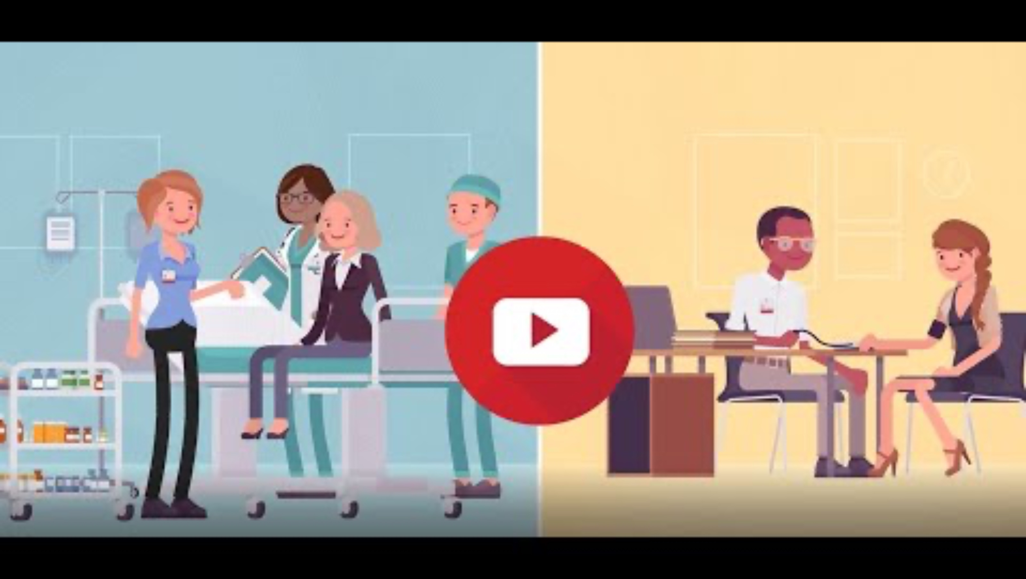

Slide 27

Client relationships with pharmacists:
What are some aspects of a professional relationship?
Respect
Trust
Empathy
Knowledge
Pharmacist are in a position of authority and must maintain a professional relationship called a therapeutic relationship.
What variation can involve clients’ families as well as the client?
Can involve a one-time interaction or can be every day or every other day for clients’ using methadone for example.
Families are often included for clients with developmental disabilities, seniors, & clients with physical impairments to name a few.

Slide 28

TECHNOLOGY
Notes:
https://www.istockphoto.com/search/2/image?mediatype=illustration&phrase=pharmacy%20tech

Slide 29

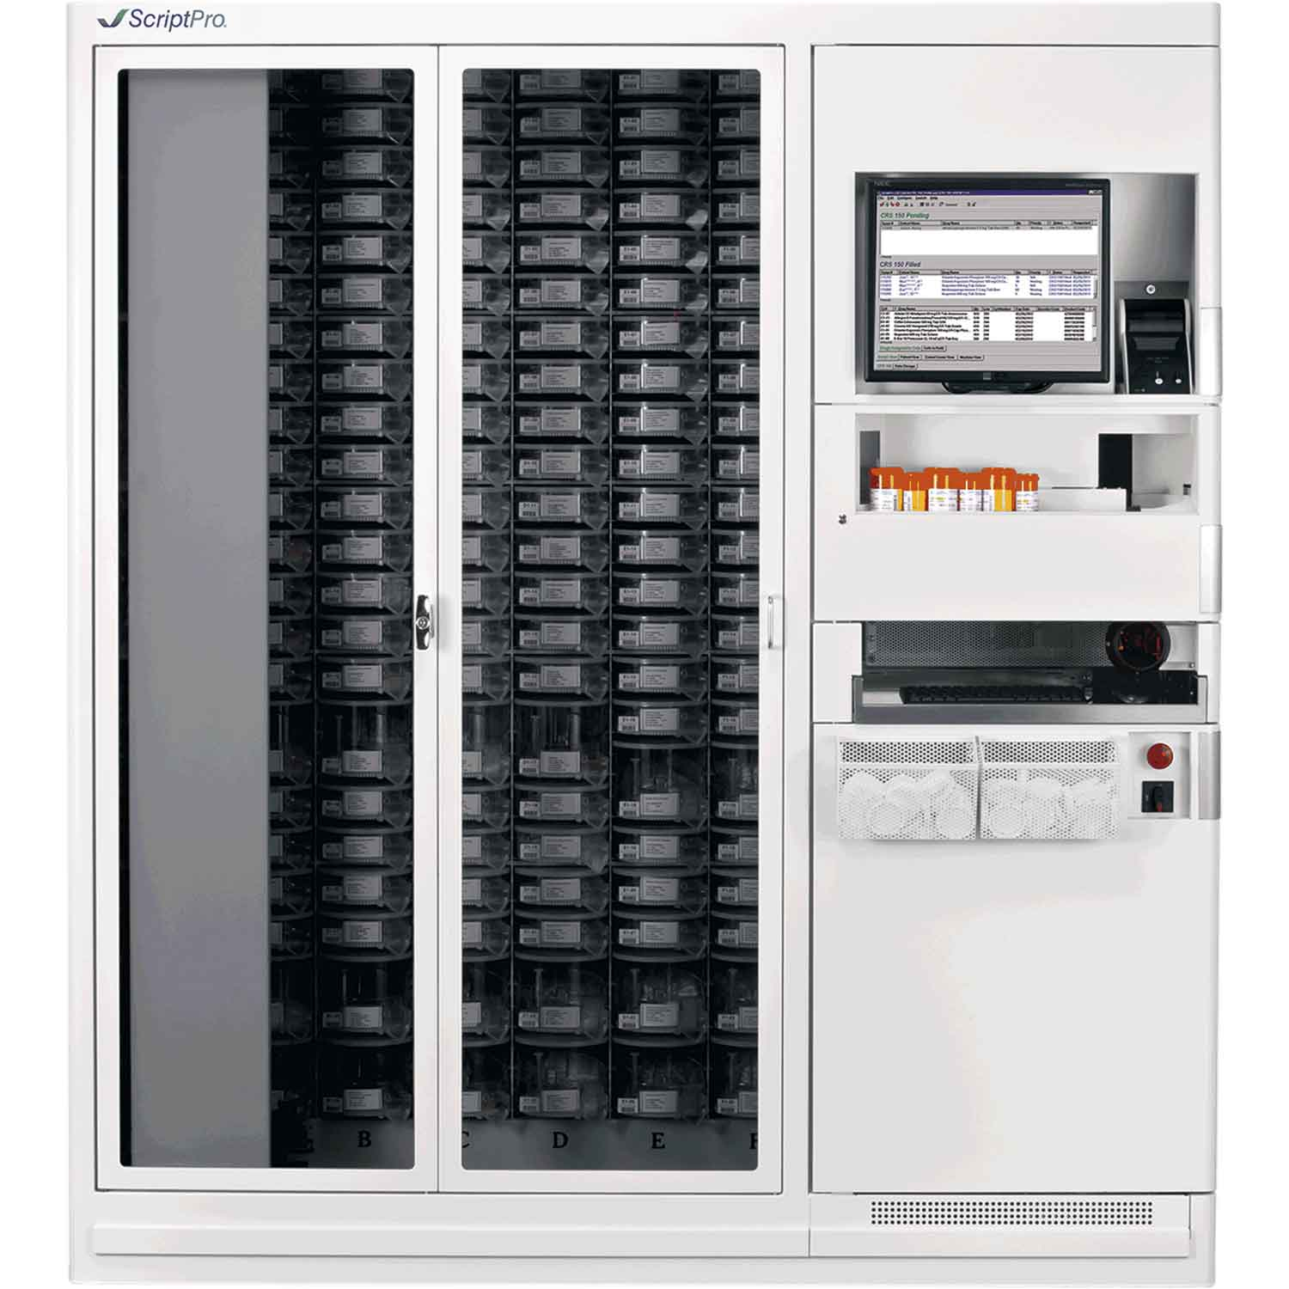
Script Pro:
A robotic system that accurately dispenses and labels prescriptions.
Helps run a stress-free pharmacy with pill count accuracy.
Better workflow from point of entry to point of sale or delivery.
Accurately fills 150 vials per hour.
Notes:
https://www.scriptpro.com/about-us#:~:text=From%20point%20of%20entry%20to,operations%20on%20this%20single%20platform.
https://www.scriptpro.com/blog/what-makes-scriptpro-robots-better-than-the-competitors
https://scriptpro.com/vial-filling/

Slide 30
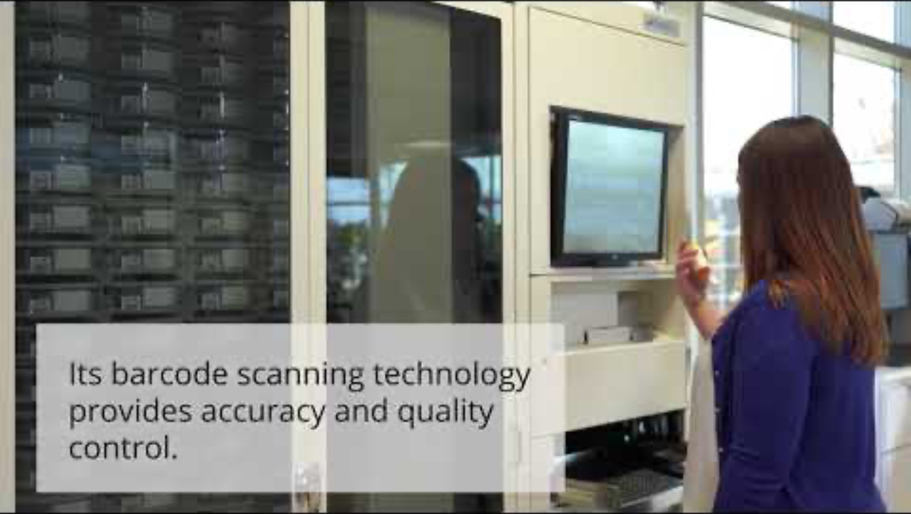
Notes:
https://www.youtube.com/watch?v=76lDXWr1SXU

Slide 31

Time-Delayed Safes
As of April 2024, all 4,900+ pharmacies in Ontario now use time-delayed safes to secure narcotics (e.g., oxycodone, morphine, codeine).
Deters Pharmacy Robberies
Improved Staff Safety
Community Protection
The initiative is supported by the Ontario College of Pharmacists (OCP) and the Ontario Association of Chiefs of Police (OACP).
Operational Guidelines:
The safe remains locked except when authorized staff are accessing it for restocking or dispensing.
Employees typically follow protocols to ensure the safe's time delay mechanism is active and properly set.
Staff should be trained on the safe’s purpose and usage to maintain security standards and minimize workflow disruptions.
Notes:
https://www.ocpinfo.com/about/key-initiatives/pharmacy-safety-initiative/

Slide 32

Management Systems
1. Kroll
Most Popular System:
  Dominates over 50% of the market share.
  Used by major chains such as:
    Walmart, Metro, Loblaws, Sobeys, Pharmasave, Costco.
2. Healthwatch
Shoppers Drug Mart System:
  Common in many Shoppers Drug Mart locations across Canada.
3. Nexxsys
Primary System for Rexall Pharmacies:
  Less Common in small, independent pharmacies.
Notes:
https://www.tnnracing.com/software/key-features-benefits-of-pharmacy-management-system-in-medical-industry.html
https://rpigroup.ca/blog/blog/the-top-three-most-common-pharmacy-systems-used-in-canada/

Slide 33
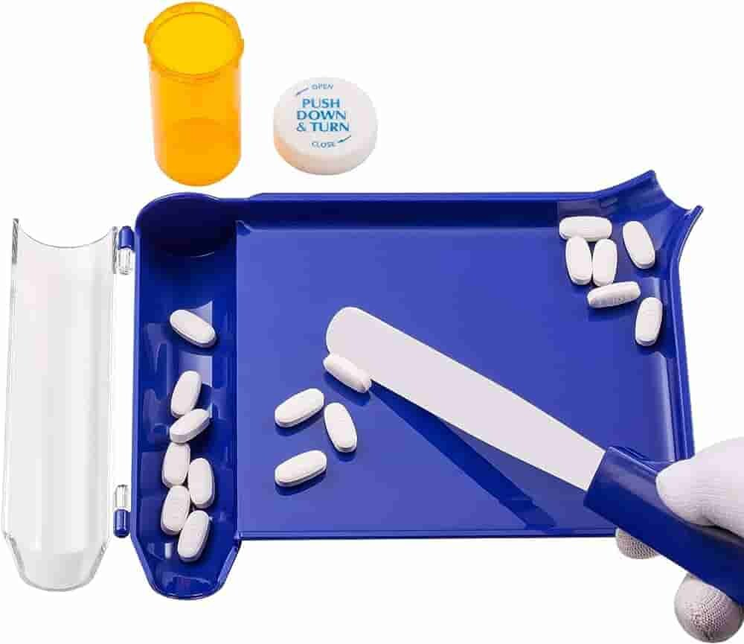
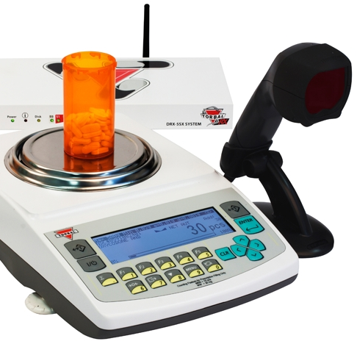
Types of Pill Counters
1.Manual Pill Counters:
These are basic devices where pills are manually placed on a counting tray and organized into groups using a spatula.
The “Count Tray” method is commonly used in small or independent pharmacies.
Suitable for pharmacies with lower prescription volumes.
2.Automatic Pill Counters:
Fully automated systems that count, sort, and dispense pills without manual input.
Often used in high-volume settings like chain pharmacies or mail-order facilities.
Notes:
https://www.ipharmachine.com/pill-counter-machine-buying-guide
https://www.fulcruminc.net/product/drx-500sxnw/96
https://rpigroup.ca/blog/blog/the-top-three-most-common-pharmacy-systems-used-in-canada/

Slide 34
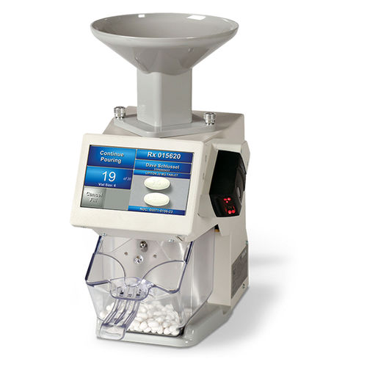
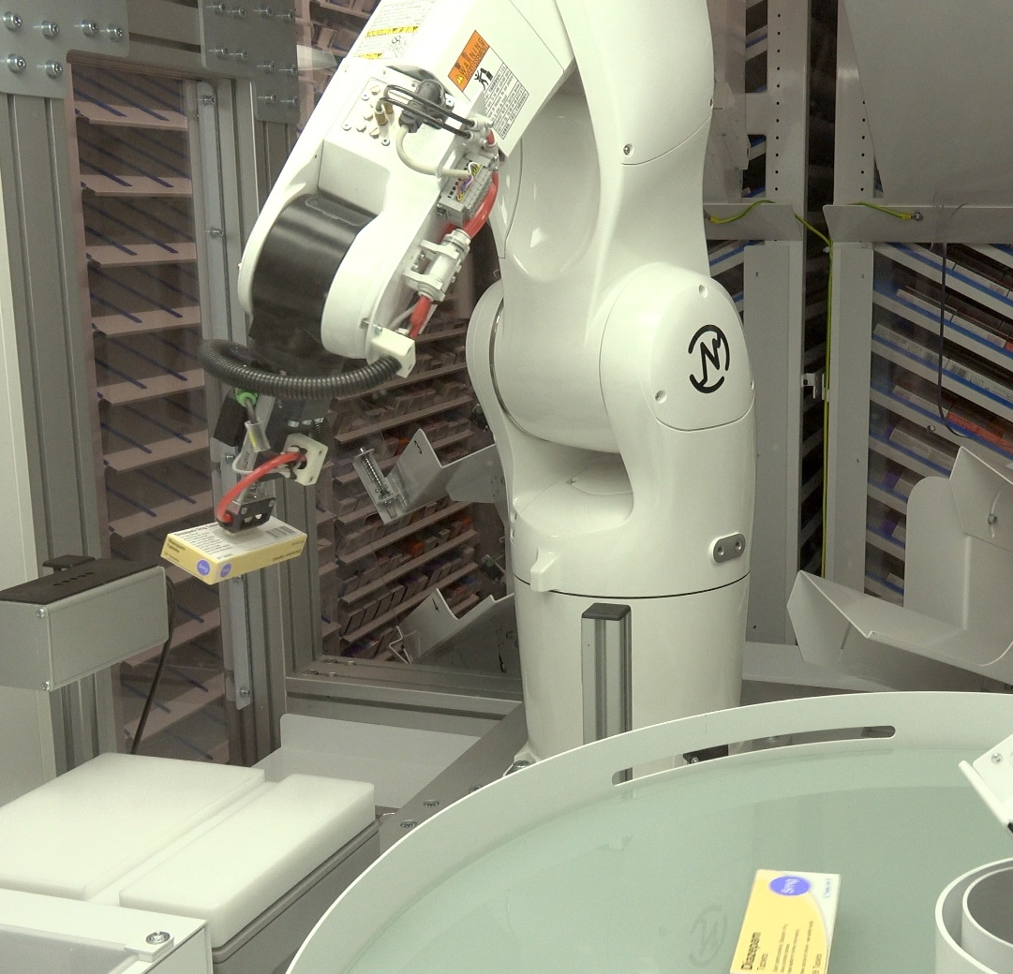
Types of Pill Counters
3.Electronic Pill Counters:
Use sensors to count pills as they pass through a dispensing chute.
Faster and more accurate than manual methods.
4.Counting Robots:
Advanced systems integrated with pharmacy management software.
Can store and count multiple medications simultaneously.
Notes:
https://www.fulcruminc.net/product/drx-500sxnw/96
https://www.medicalexpo.com/prod/kirby-lester/product-100260-651861.html
https://rpigroup.ca/blog/blog/the-top-three-most-common-pharmacy-systems-used-in-canada/

Slide 35
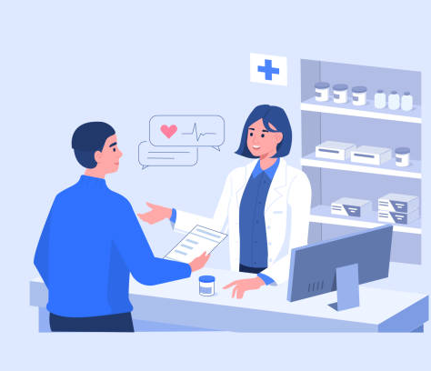
SKILLS
Notes:
https://www.istockphoto.com/search/2/image?mediatype=illustration&phrase=pharmacist

Slide 36

What are the necessary skills needed for this profession?
Communication and interpersonal skills
Attention to detail
Problem solving/ analytic skills
Detail orientated
Efficient time management skills
ThePhoto by PhotoAuthor is licensed uder CCYYSA.
ThePhoto by PhotoAuthor is licensed under CCYYSA.

Slide 37

Conclusion
The pharmacist profession is the foundation of the healthcare and a diverse field with many different roles, settings, and responsibilities.
With a thorough educational, training requirements and a mandatory licensing process, pharmacists are fully prepared to manage, dispense medications, and prescribe for few conditions to ensure safe patient care, and provide the necessary health information.
Pharmacists cover different areas, ranging from community pharmacies to hospitals, including specialties like nuclear pharmacy, consultancy, and the pharmaceutical industry.
Pharmacists work hand-in-hand with other healthcare professionals, insuring patient care through effective collaboration.
The recent broadening of their scope role, including prescribing for minor ailments, reflects their growing position and the belief in their capabilities by the healthcare system.
Pharmacists are essentials in promoting health starting with educating patients, to dispense prescriptions, and utilizing advanced technology to increase productivity.
Communication skills, attention to details, problem-solving, and time management are the keys to succeed in this human-centered profession.
As their scope of practice is expanding and taking more responsibility, the contribution they are having in healthcare community is incredibly important. Ensuring that patients receive holistic care with professionalism and compassion.
Notes:
https://www.istockphoto.com/search/2/image?mediatype=illustration&phrase=medication

Slide 38

QUIZ

Slide 39

Question 1:
TRUE OR FALSE:
Mild asthma attacks is one of the 19 minor ailments that pharmacists can provide medications for.

Slide 40
Question 1:
TRUE OR FALSE:
Mild asthma attacks is one of the 19 minor ailments that pharmacists can provide medications for.
FALSE: it is not one of the 19 minor ailments.

Slide 41
Question 2:
What group must a pharmacist be licensed with in Ontario?
A) Ontario Medical Association (OMA)
B) Canadian Pharmacy Association (CPA)
C) Ontario College of Pharmacists (OCP)
D) Health Canada

Slide 42
Question 2:
What group must a pharmacist be licensed with in Ontario?
A) Ontario Medical Association (OMA)
B) Canadian Pharmacy Association (CPA)
C) Ontario College of Pharmacists (OCP)
D) Health Canada

Slide 43

Question 3:
Where can pharmacists work?
A) Grocery stores
B) Hospitals
C) Primary Healthcare offices
D) All of the above

Slide 44
Question 3:
What can pharmacists work?
A) Grocery stores
B) Hospitals
C) Primary Healthcare offices
D) All of the above

Slide 45

Question 4:
What date were pharmacists allowed to prescribe medication for 19 minor ailments?
A) January 5, 2024
B) January 1, 2023
C) December 15, 2023
D) October 1, 2023

Slide 46
Question 4:
What date were pharmacists allowed to prescribe medication for 19 minor ailments?
A) January 5, 2024
B) January 1, 2023
C) December 15, 2023
D) October 1, 2023

Slide 47
LITERATURE CITED
Canadian Pharmacists Association. How to become a pharmacist in canada. 2024. Available at https://www.pharmacists.ca/pharmacy-in-canada/becoming-a-pharmacist-in-canada/. Accessed Nov 25, 2024
CDHO. Guideline recommending, prescribing, dispensing and selling drugs in practice. [Internet] Feb 2015 [Cited 2024 Dec 3]; Available from: https://cdho.org/wp-content/uploads/2023/10/GUI-Prescribing.pdf
Christie M. 6 Key Advanced Pill-counting Features Pharmacies Should Consider [Internet]. 2022 Dec 15 [Cited 2024 Dec 13]. Available from: https://insights.covermymeds.com/healthcare-technology/automation/6-key-advanced-pill-counting-features-pharmacies-should-consider
Cleveland clinic. Pharmacist. 2023 March 02. Available from: https://my.clevelandclinic.org/health/articles/24786-pharmacist. Accessed December 1, 2024.
College of Pharmacists of Manitoba. Practice guideline for professional boundaries in therapeutic relationships. [Internet] [Cited 2024 Dec 3]; Available from: https://cphm.ca/wp-content/uploads/Resource-Library/Guidelines/Therapeutic-Relationships.pdf
College of Dental Hygienists of Ontario. Guideline: recommending, prescribing, dispensing and selling drugs in practice. 2015. available from: https://cdho.org/wp-content/uploads/2023/10/GUI-Prescribing.pdf Accessed December 3, 2024
College of Pharmacists of Manitoba. Practice guideline for professional boundaries in therapeutic relationships. Available at: https://cphm.ca/wp-content/uploads/Resource-Library/Guidelines/Therapeutic-Relationships.pdf Accessed December 3, 2024.
Indeed. What are pharmacy skills. 2024 Jan 22. Available from: https://ca.indeed.com/career-advice/resumes-cover-letters/pharmacy-skills . Accessed December 3, 2024.
Mayo Clinic. Pharmacist. Available at: https://college.mayo.edu/academics/explore-health-care-careers/careers-a-z/pharmacist/ Accessed: Dec 3, 2024
Mayo Clinic. Pharmacist. 2023. Available from: https://college.mayo.edu/academics/explore-health-care-careers/careers-a-z/pharmacist/ Accessed December 3, 2024

Slide 48
LITERATURE CITED
OCOP. Pharmacy Safety Initiative [Internet]. 2024 Apr 11 [Cited 2024 Dec 13]. Available from: https://www.ocpinfo.com/about/key-initiatives/pharmacy-safety-initiative/
Ontario college of pharmacists. Minor ailments. 2024. Available from: https://www.ocpinfo.com/practice-education/expanded-scope-of-practice/minor-ailment/ Accessed on: December 3, 2024
Ontario Pharmacists Association. Become a pharmacist. 2024. Available from: https://www.opatoday.com/become-a-pharmacist/#:~:text=It%20takes%20at%20least%20five,therapeutic%20knowledge%20and%20clinical%20skills. Accessed December 01, 2024.
Ontario College of Pharmacists. Scope of practice. Available at: https://www.ocpinfo.com/practice_resource/scope-of-practice/ Accessed on: Dec 3, 2024
Ontario Pharmacy Association. Become a ppharmacist. 2024. Available at: https://www.opatoday.com/become-a pharmacist/#:~:text=It%20takes%20at%20least%20five,therapeutic%20knowledge%20and%20clinical%20skills.%E2%80%8B. Accssed on Nov 25, 2024
Pharmacists’ Gateway Canada. Working as a pharmacist. Available at: https://www.pharmacistsgatewaycanada.ca/pharmacy-practice/working-as-a-pharmacist/#:~:text=Pharmacists%20work%20alongside%20doctors%2C%20nurses,and%20new%20drug%2Dresearch%20findings Accessed: Dec 3, 2024
RPI. The Top Three Most Common Pharmacy Systems Used in Canada [Internet]. 2018 Aug 28 [Cited 2024 Dec 13]. Available from: https://rpigroup.ca/blog/blog/the-top-three-most-common-pharmacy-systems-used-in-canada/
University of Toronto. How to become a pharmacist. Available at: https://www.pharmacy.utoronto.ca/how-become-pharmacist. Accessed on: Dec 1, 2024

