Slide 1

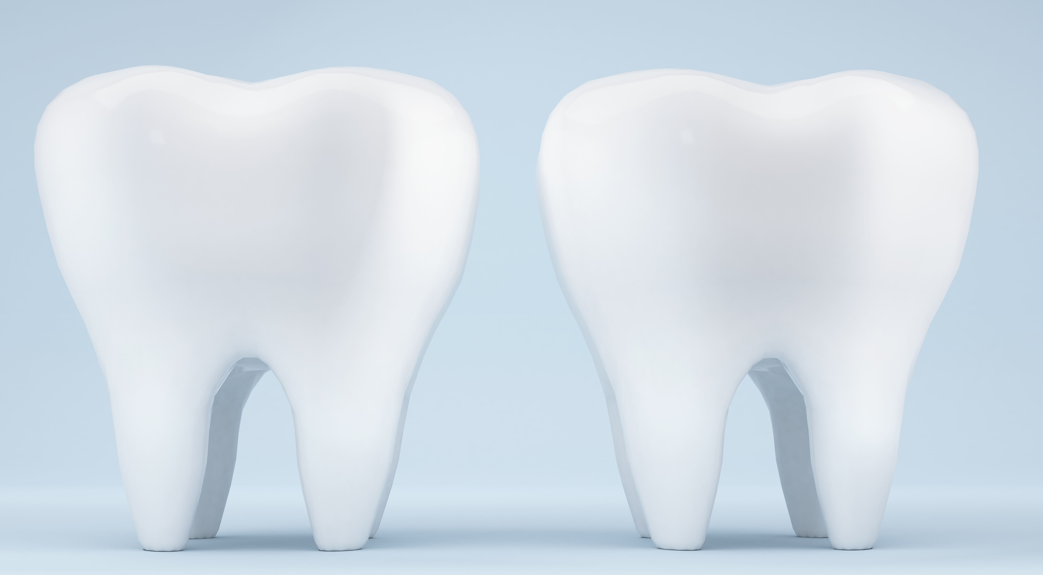

Client Recruitment, Retention, Transfers and Terminations.
DH 401: consolidation.
Mrs. Harishni Ramesha RDH.
MEGAN WALBAUER, ZAID SAOOR, JAIPREET SINGH, ALEJANDRO PATRICKSON, SARAH SPENCER, ANGEL NOORANI, GAGANDEEP KOHLI.

Slide 2
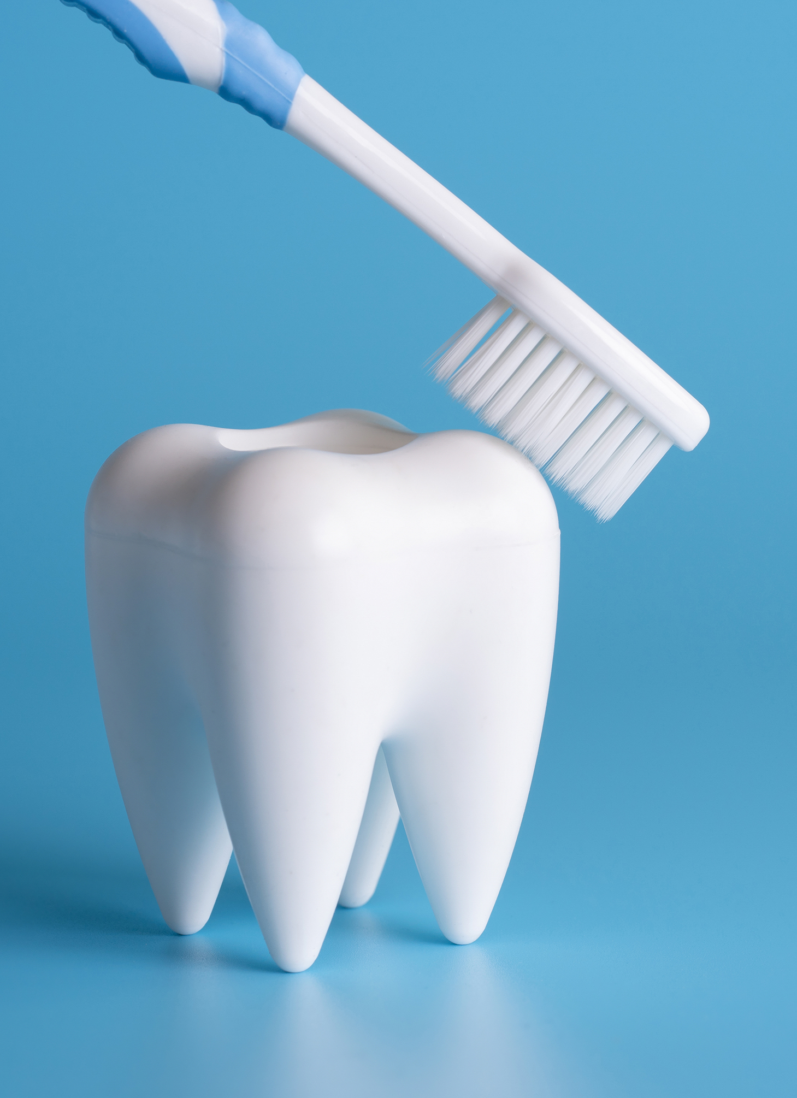
Table of contents:
Introduction
Client recruitment
Retention of clients'
Termination
Transfer of clients'
Things that worked for us
Questions

Slide 3

Introduction:
Management of clients becomes a big portion of this program. It’s important to have the skills required to effectively manage our clients to ensure the best client care.

Slide 4

Client recruitment:
Facebook, karrot, Kijiji, next-door, Instagram, craigslist
Have written descriptions saved in notes
Be forthcoming with them
Encourage for clients to pay for their own care
Ask lots of questions
Screen prior to care
Accurate cost

Slide 5
Client recruitment
REQUIREMENTS OF CADH:
Words that cannot be used “free, no cost, reimbursement/reimburse” (CADH 2023).
Use words like “low cost” (CADH 2023).
Communication through school email or cell phone but use caution (CADH 2023).
Your responsibility to ensure that you have a client for each clinic (CADH 2023).
Services that are listed at CADH (CADH 2023)
Whitening, sports guard fabrication, nutritional counselling, oral cancer screening, tooth polish, debridement, fluoride, dental referrals. (CADH 2023, p.21).

Slide 6
Retention of clients:
Build strong client relationships (warm welcome, establish trust)
Be professional (punctual, show respect)
Reinforce the value of returning (perform effective and detailed oral hygiene education)
Be organized (review client chart ahead of time, manage time efficiently)
Be thorough in providing care
Good communication skills (active listener, ask open ended questions, follow up)

Slide 7
Retention of clients
Treat retention of clients like a business: always use their name, use professional but inviting language, be clear and honest about what your services are, genuinely thank them for being your client and invite them to come back.
During the clinical session prioritize your current clients, ask their availability and schedule quickly and all necessary appointments to ensure their care is being completed in a timely manner.
Meet your clients where they are at – everyone displays different health belief models; every tiny change they make is an improvement and builds trust.

Slide 8
Client Termination:
Why Termination May Be Necessary
  We aim to avoid terminating client care, but sometimes it is required when issues arise in the clinic.
  Certain behaviors disrupt clinic operations and justify termination.
Valid Reasons for Termination (CADH 2023)
  Missing two or more consecutive appointments without notice.
  Last-minute cancellations without a valid reason.
Communicating with Clients (CADH 2023)
  Respectfully inform the client about their behavior.
  Explain that if issues persist, care may be terminated.

Slide 9
Client Termination:
Clinic Time is Precious
  You may choose not to terminate care.
  However, unreliable clients impact clinic time and efficiency.
Documentation & Approval Process (CADH 2023)
  Document reasons for termination in the communication log.
  Provide the clinical coordinator with a detailed report.
  The coordinator reviews the situation and decides on termination.

Slide 10
Client Termination:
Client Termination Process (CADH 2023)
  If termination is approved:
  Fill out the Client Termination Form and submit it to faculty.
  The termination form must be affixed in Section 1 in the chart, in front of the invoice.
  If the client is unhappy, faculty will handle the discussion and document it in the communication record
Client-Initiated Termination (CADH 2023)
  Clients may request termination, often at the end of their treatment.
  Similar procedures apply—priority is to document their request.
Finalizing the Process
  After termination, return the chart to reception.
  Reception will finalize the process.

Slide 11

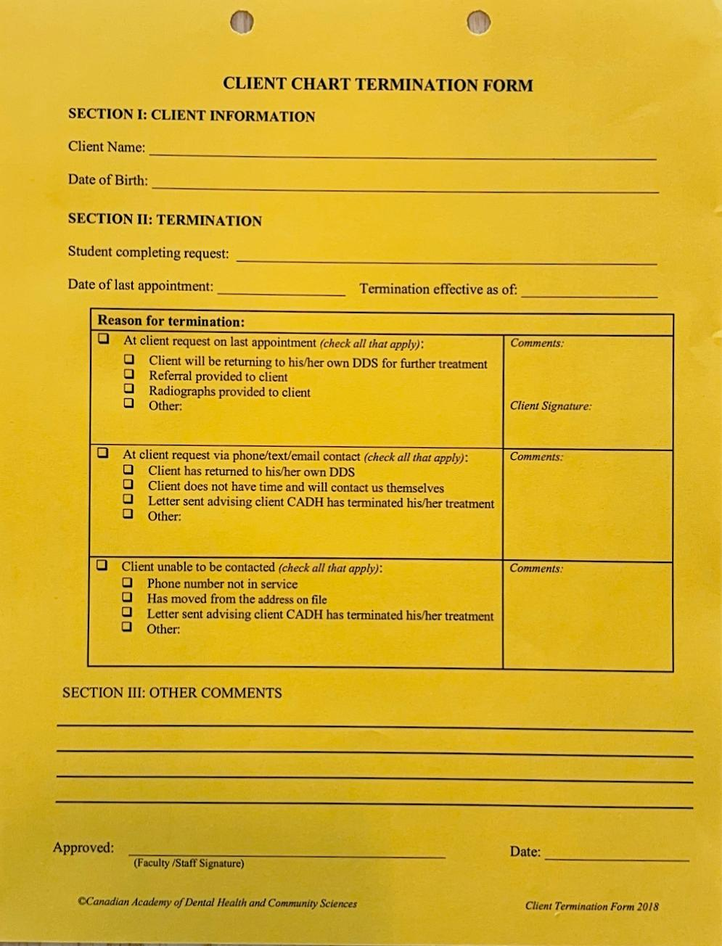


Termination Form:

Slide 12

Transfer of clients:
Client Transfer Request
Students have the opportunity to transfer clients in their client pool to other students to help them meet their own clinical competency requirements, to support other students, and to meet client needs. (CADH 2023).
All client transfer requests must be approved before proceeding.
To receive approval for a transfer request, the following steps must be completed:
1st Discuss the transfer with another student and obtain agreement (Student 2)
2nd Discuss the transfer with the client and obtain consent
3rd Update the Communication Record (CADH 2023).
NOTE: Although there are physical copies of transfer request forms, they are for in-persons transfer. Approval is to be obtained via email by following the underlined procedure: (CADH 2023).

Slide 13
Transfer of Clients’:
Client Transfer Request template:
The client’s name
Your name (Transfer from: _______)
The name of the student to whom the client is being transferred (Transfer to: ________)
The reason for the transfer
Date of last DH care /debridement (Hyg) – include even if the client has not yet been seen at CADH
Verification that the client agrees to be transferred to the other student
Confirmation that the Communication Record has been updated with the details of the discussion; including the request for a transfer

Slide 14
Client Transfer request form:
Client name: (LAST NAME, First Name)
Transfer from:
Transfer to:
Reason for transfer:
Date of Last Hyg:
Client consent:
Comm. Record updated:

Slide 15



Email information regarding transfer:
Email the 1) Clinical Coordinator,
2) Clinic Lead for your level, and
3) Reception – and
4) copy the student you are transferring the client to.
Email Subject Line: Client Transfer Request
Body of the email: Completed template
Note: All required information should be included in the template – no need to include additional information in the email unless necessary.
Student 2 must reply to all acknowledging agreement to accept the client into their client pool.
If the transfer request is approved, an email response will be provided to all.
Cases cannot be transferred to another student once the EOE and/or IOE have been started by a student (clinic manual 2023)
Do not do Multiple transfers of client to different student clinicians during the process of dental hygiene care (clinic manual 2023)

Slide 16

TIPS THAT WORKED FOR US:
And what to look out for.

Slide 17
Megan:
Boosting ads on Facebook
Being completely transparent about prices and time in the chair
Multiple reminders

Slide 18
Jaipreet
Posting a picture of yourself
Picture of the clinic so clients are aware of the environment and know what to expect
Providing transportation
Use family, friends through families

Slide 19
Angel:
A good network of your friends can provide you with probable clients.
Educated them why regular dental hygiene is important.
For client retention, always followed up with clients to maintain clientele. (Remember, there will be recalls in L4).

Slide 20
Gagan:
Use Your Network-
Ask friends and family to be your clients—educate them on why dental hygiene matters!
1
Listen and Comfort
Listen to clients, acknowledge their concerns, and offer breaks if needed to keep them comfortable and relaxed.
2
Stay Organized
Plan ahead, book early, and always have a backup client ready.
3

Slide 21
Sarah:
Posted online: Facebook, Kijiji, Next-door app
Became friends with group before who often passed on clients
Made posters and business cards, dropped off at local businesses
Approached people in person
Lots of clients from work

Slide 22
Alejandro
Went to local shelters
Mostly focused on the homeless population
Provided transportation to my clients who did not have the means to attend clinics
Took good care of my clients and my advertisement was spread through word of mouth at the shelter

Slide 23
Zaid:
Post regularly on Facebook Marketplace and Kijiji.
Share with family, friends, neighbors, and people you meet. Highlight that your services are low-cost.
Listen actively, encourage, and advise based on individual needs. Keep notes for reference.
Schedule kids during breaks to avoid school disruption.
Use texts and calls for reminders; have a backup for cancellations.

Slide 24
LITERATURE CITED
Canadian Academy of Dental Health and Community Sciences. Clinical manual. Mississauga, ON; 2023: 33
ODHA. Tips for recruiting clients for clinical requirements at school. [internet] 2022 [cited 2025 April 20]; available from: https://odha.on.ca/wp-content/uploads/2022/09/Recruiting-Clients-for-Clinical-Requirements.pdf

